Slide 1
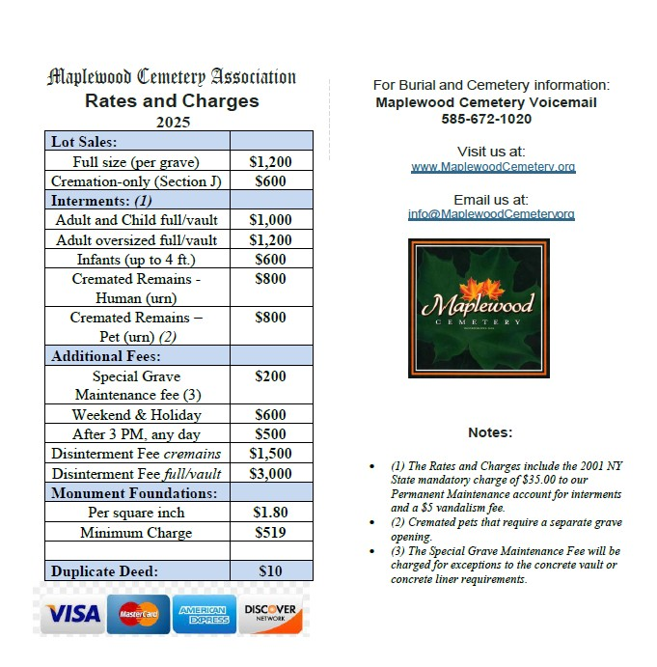
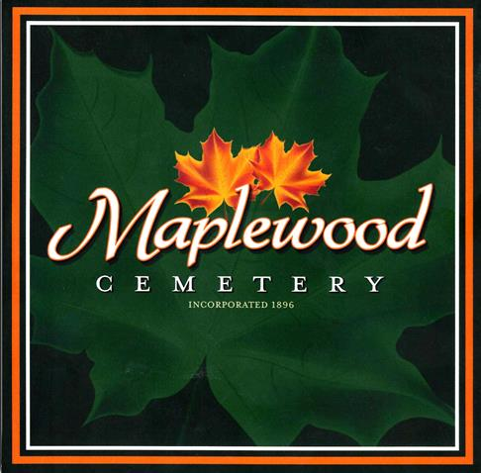
Maplewood Cemetery
Financial Operations Overview

Slide 2
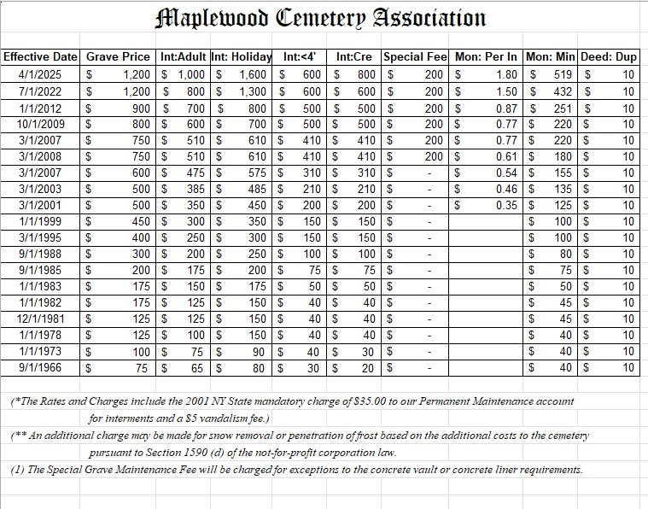

Slide 3
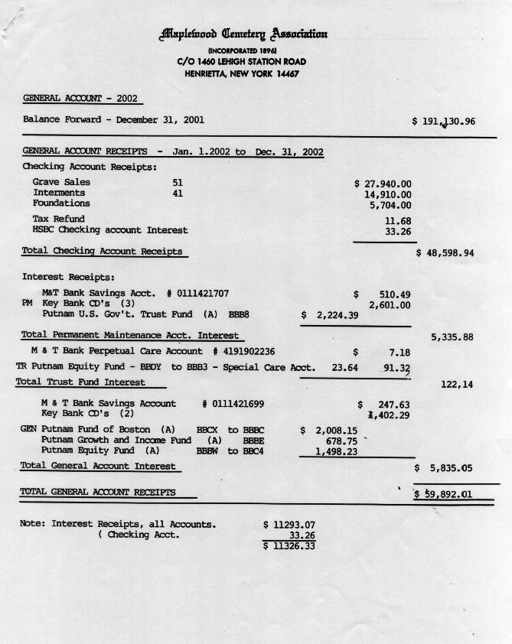
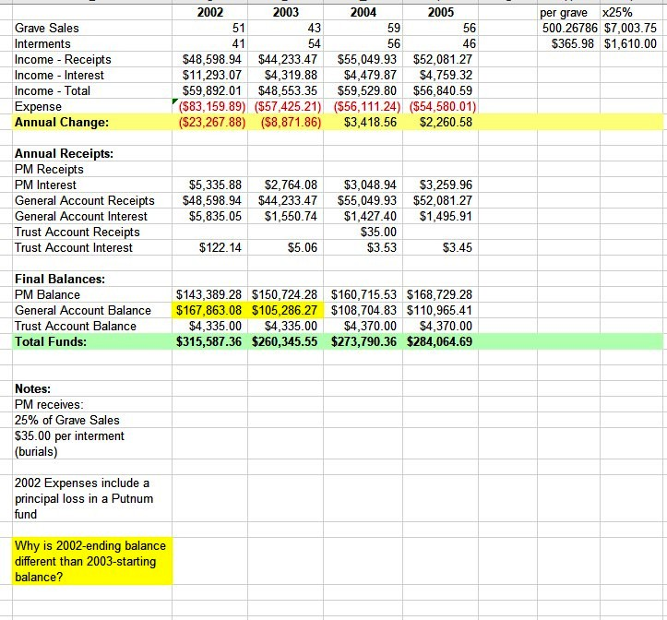
Analyze – how is our business doing?

Slide 4
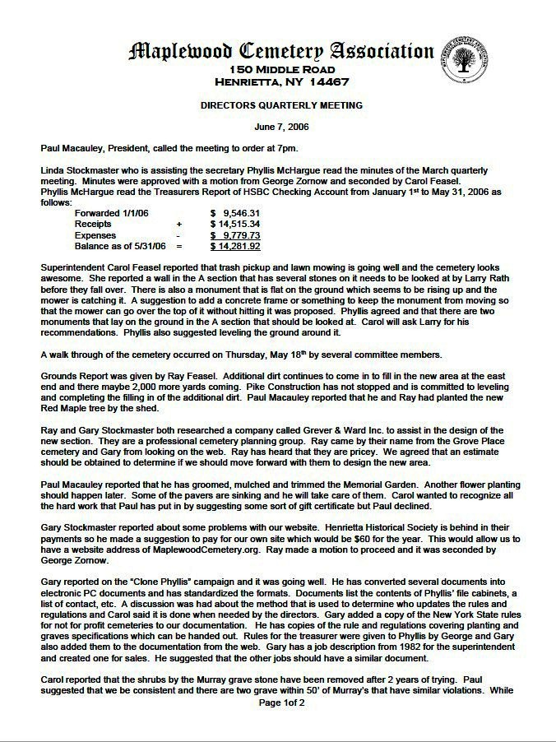
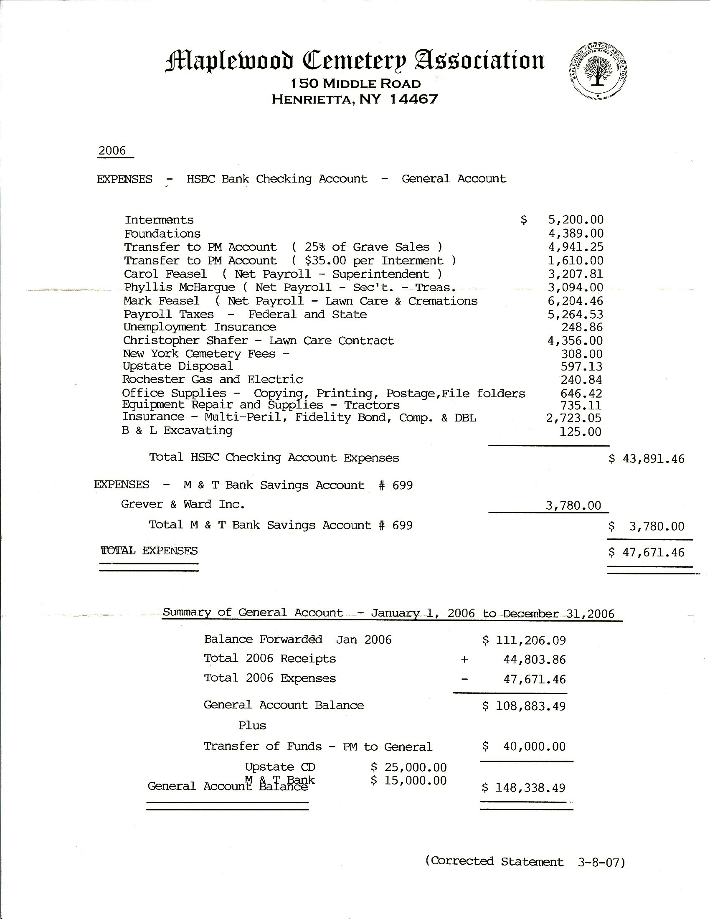
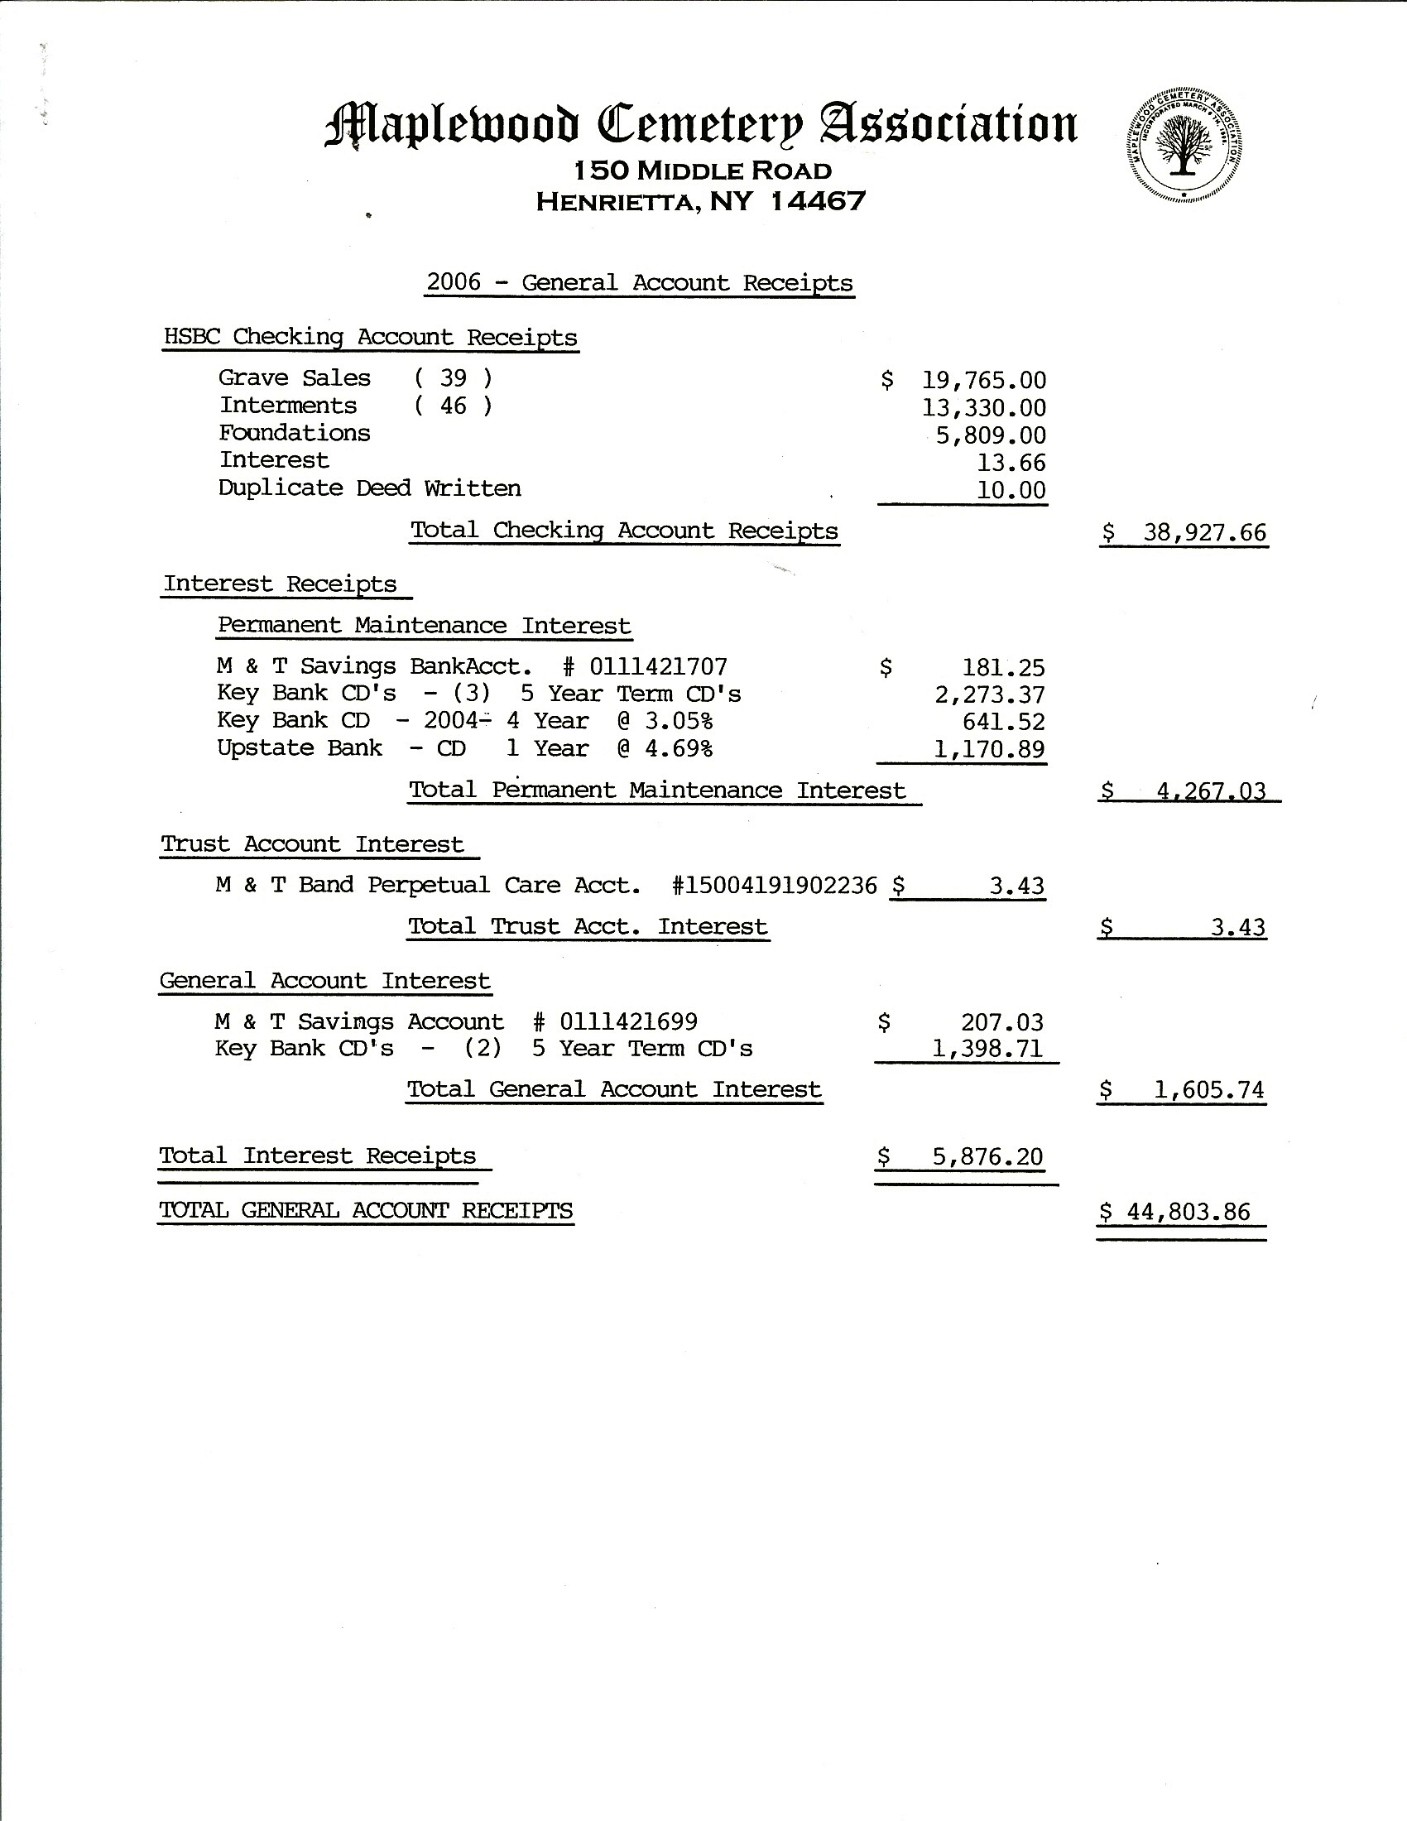
Presenting the financial reports (2006)

Slide 5
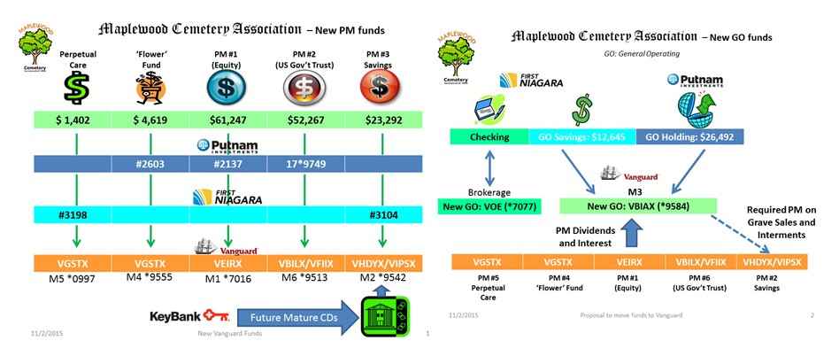
Managing the accounts
Accounts were analyzed, simplified and optimized.

Slide 6
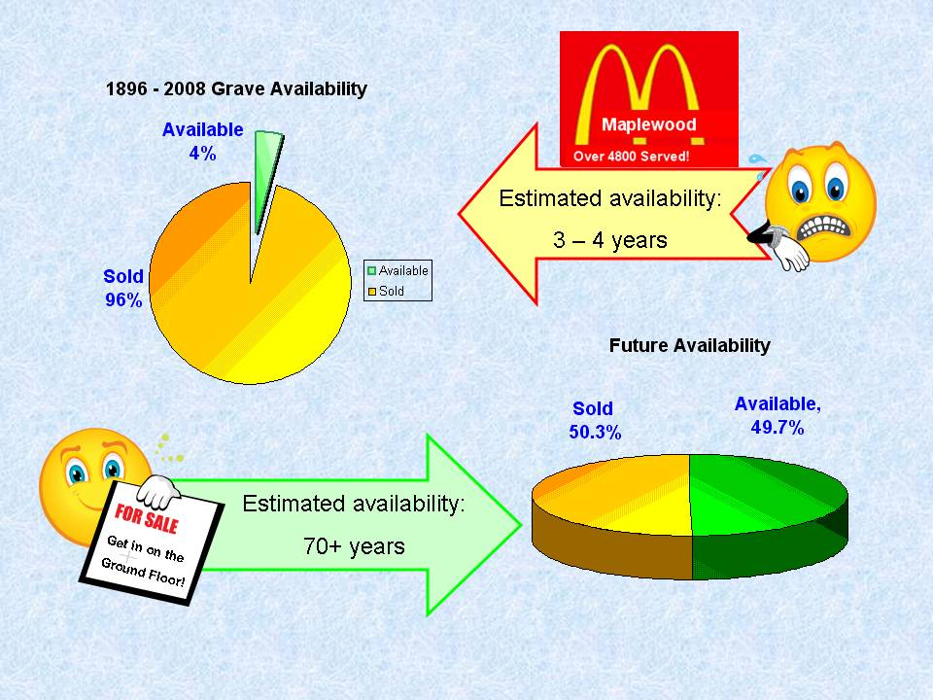
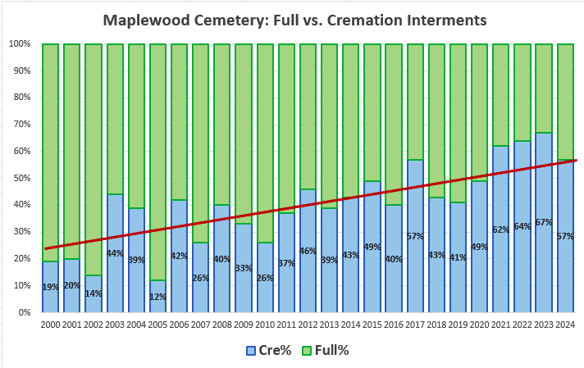
What’s the business forecast?

Slide 7
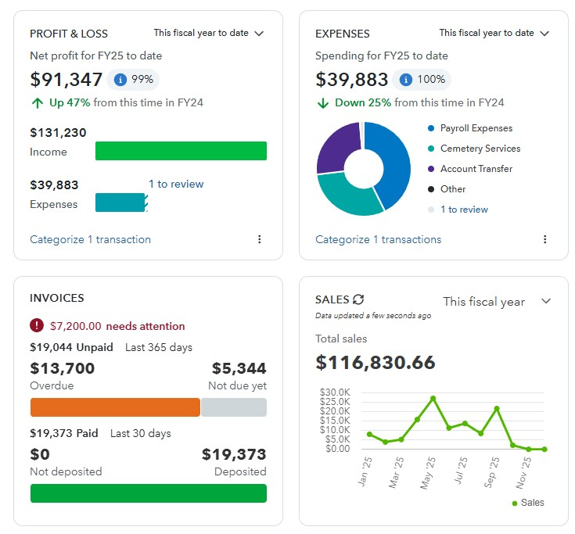
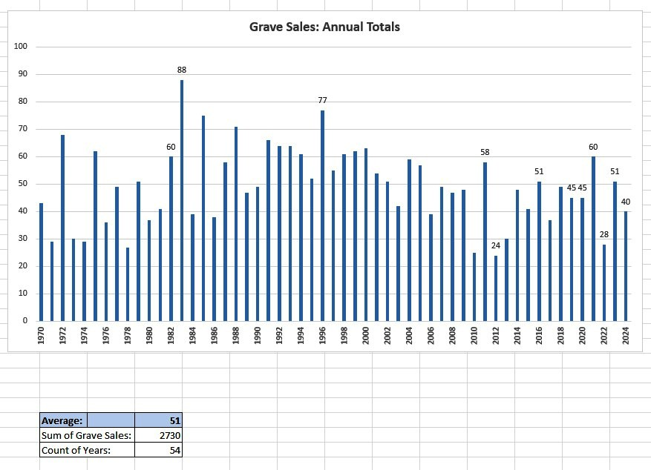
Tracking…..

Slide 8
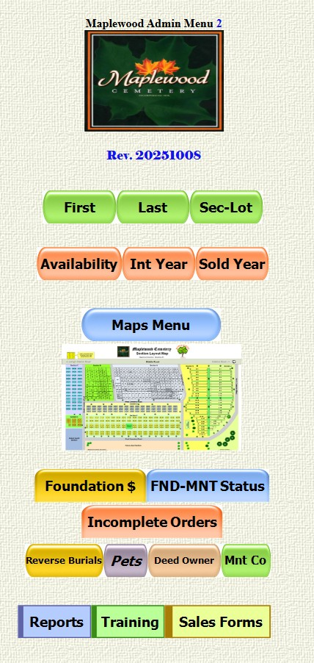
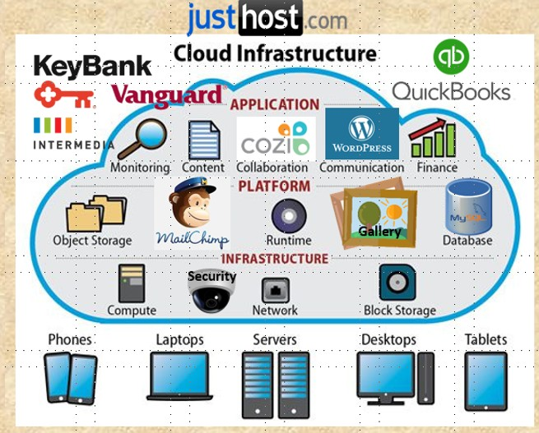
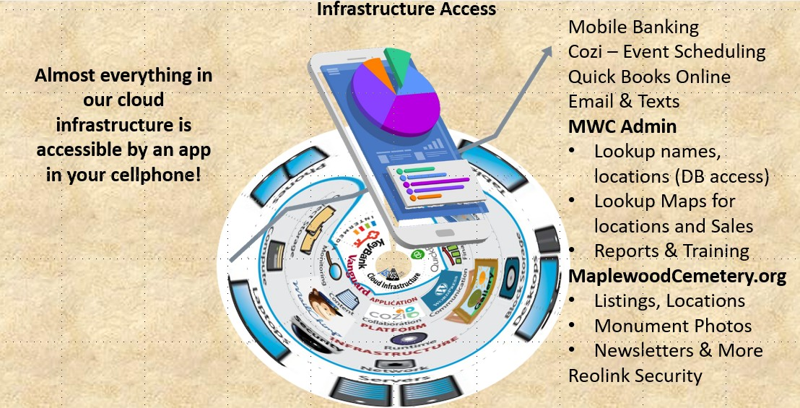
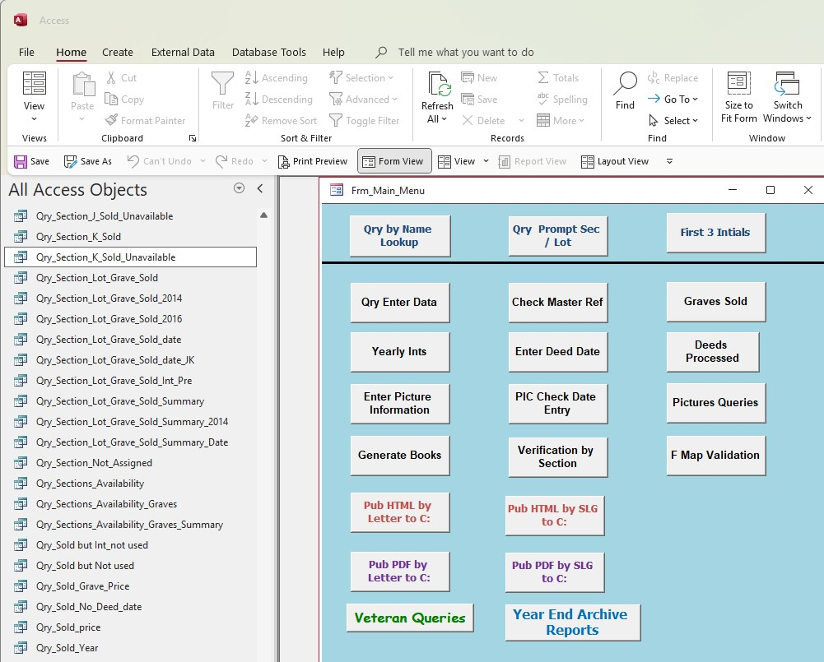
Keep accurate data, use the tools
The technology has changed. So must we…..

Slide 9
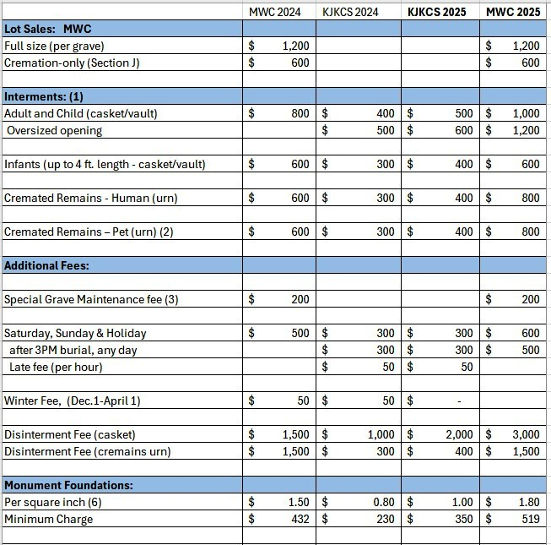
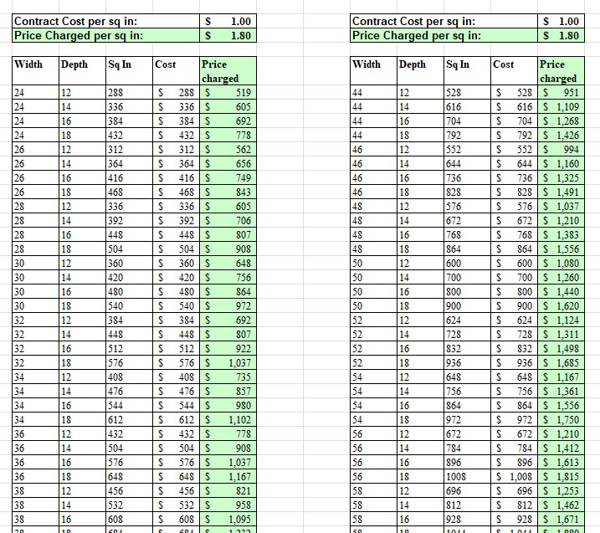
What drives our prices?

Slide 10
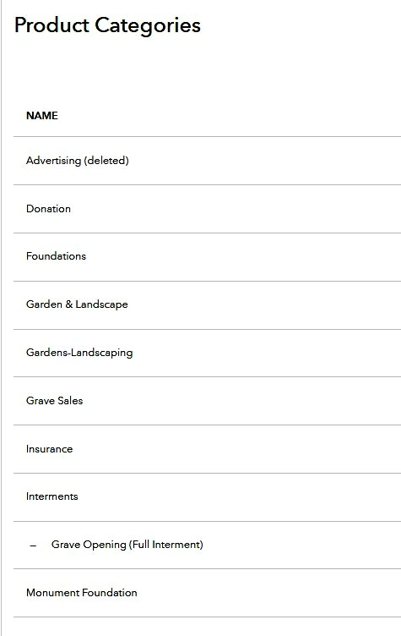
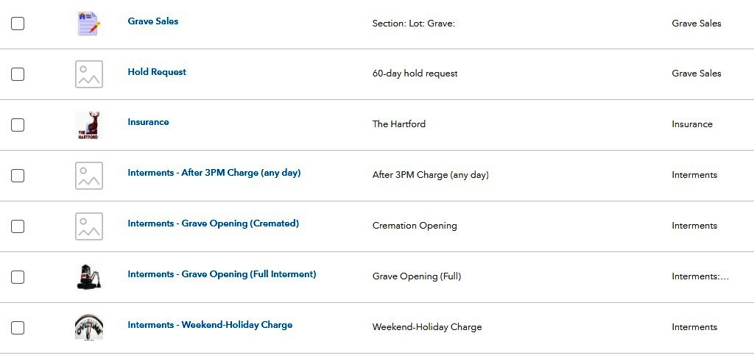
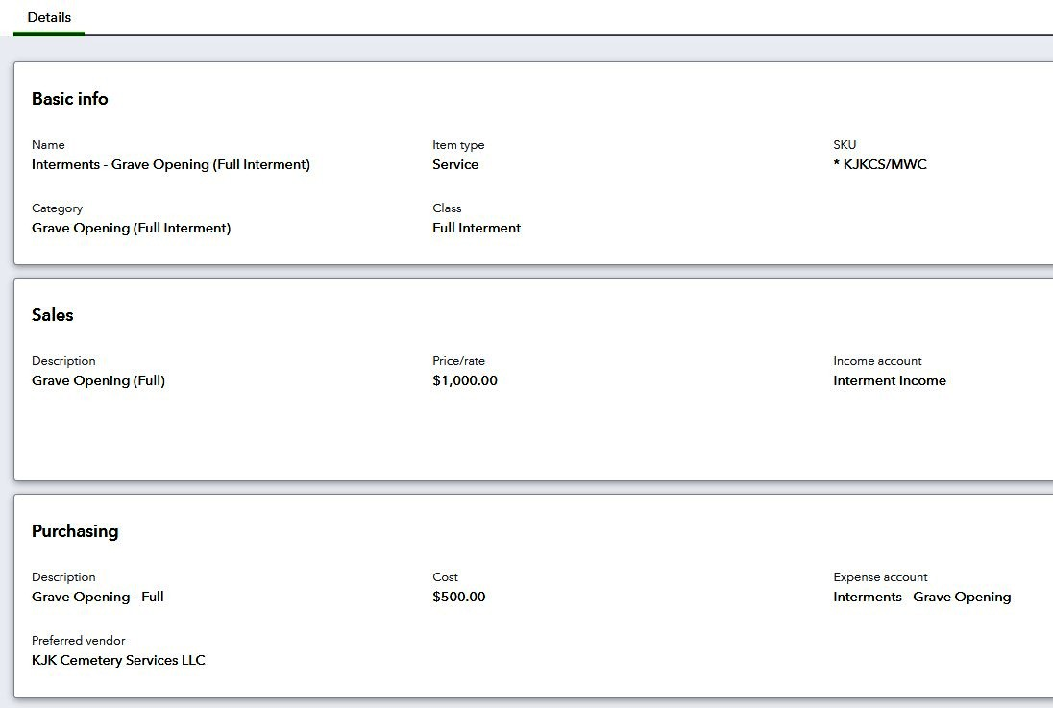
QuickBooks is our primary financial tool

Slide 11
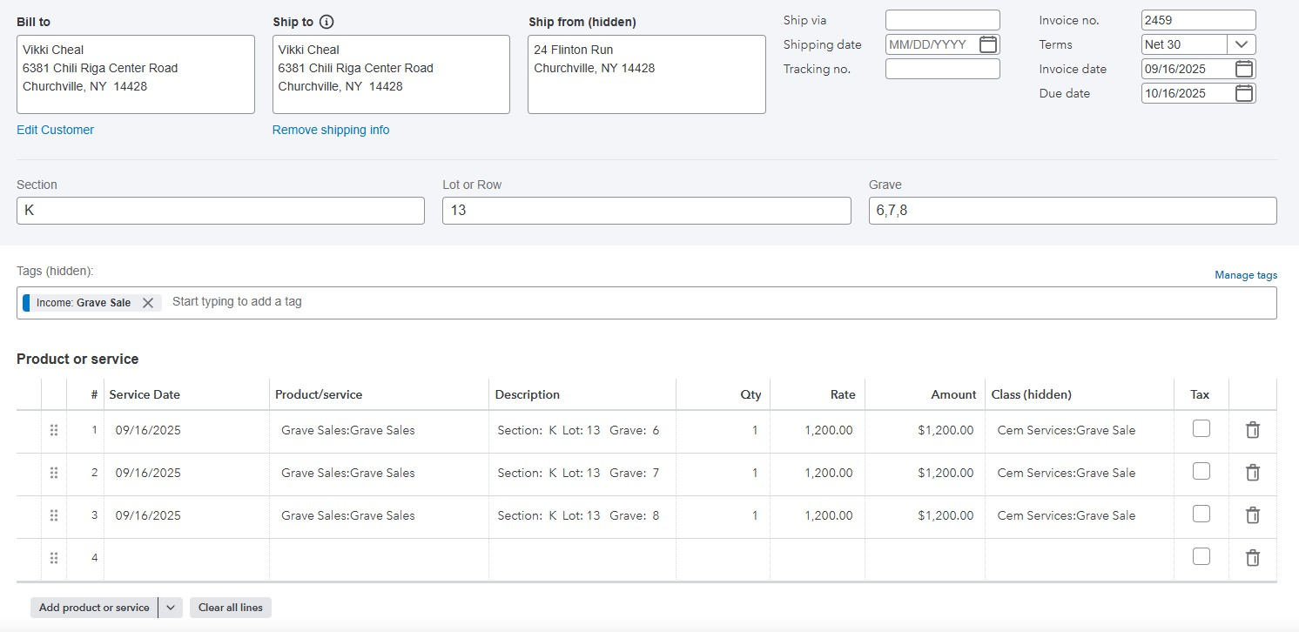
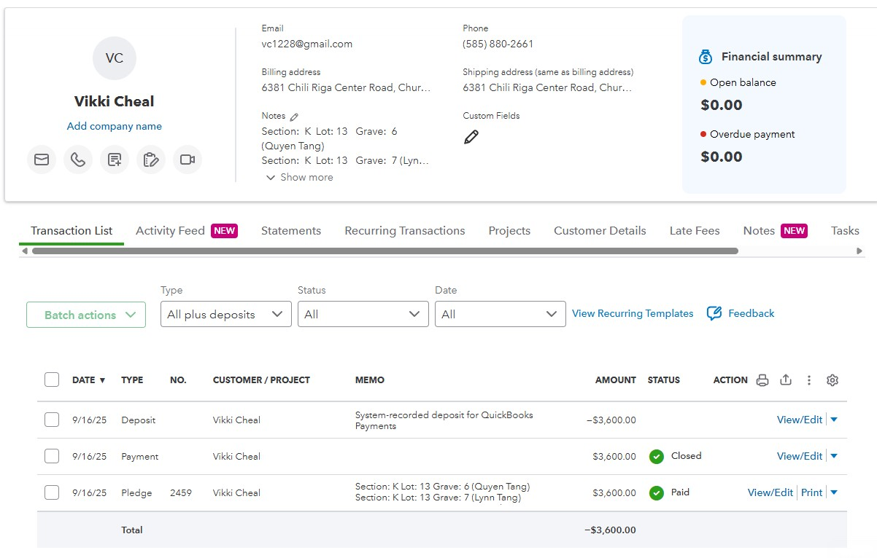
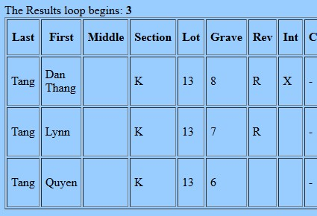
QBO Grave Sale
QBO generates the sales invoice and records the payments to the customer account.
The ACCESS Database must be updated manually to record the sale location and owner.
The ACCESS Database is the Master Record of all graves.
The new records are then uploaded to MWCAdmin.
Results from searching for DEED Owner in MWCAdmin

Slide 12
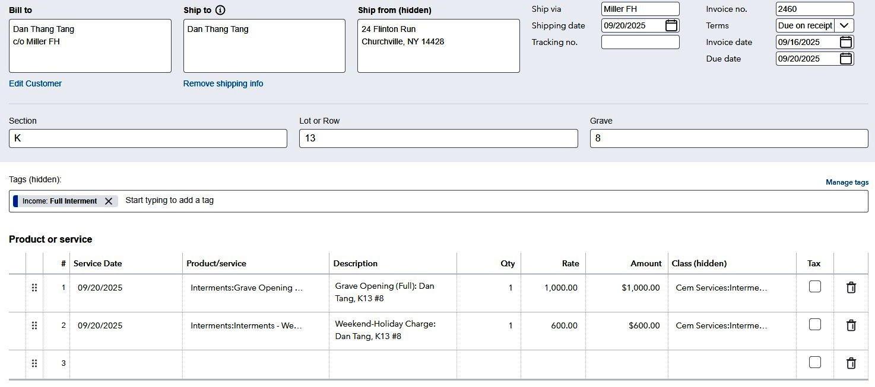
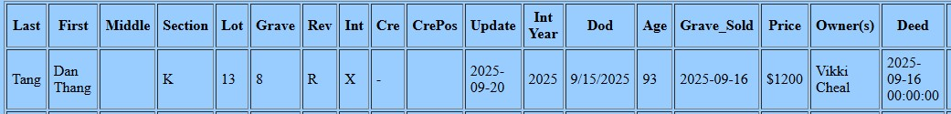
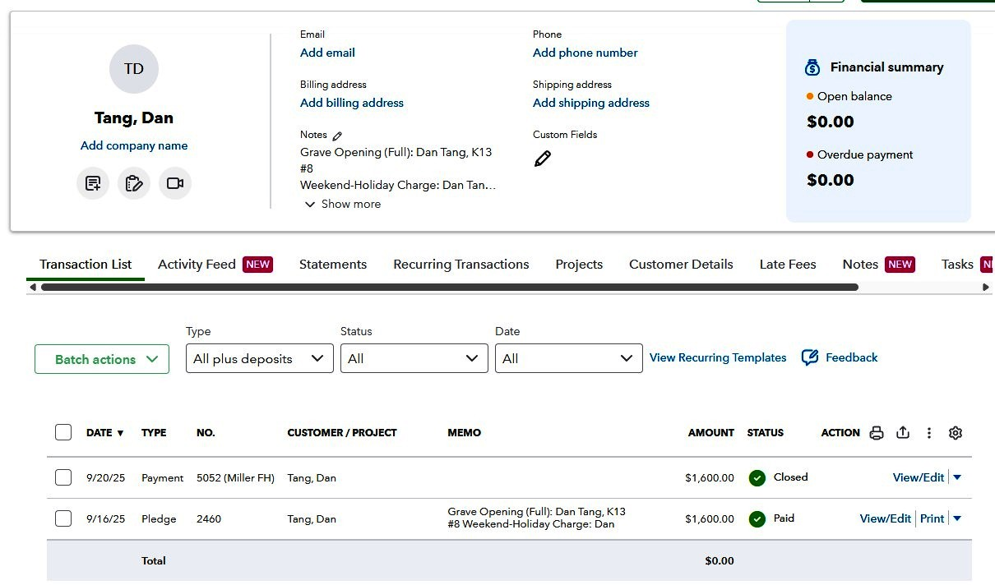
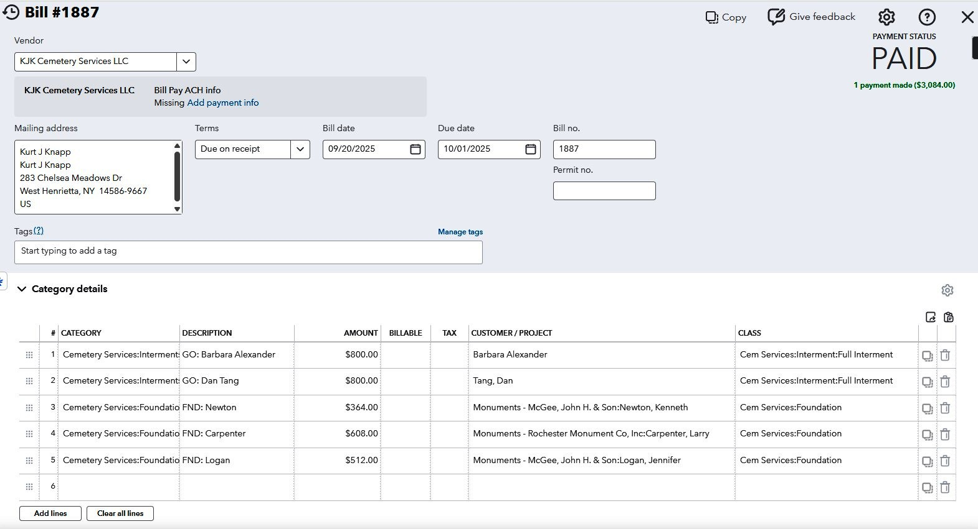
QBO Interment, (full)
Pledge Invoice), Payment, Expense
Verify that Grave has been paid for:

Slide 13
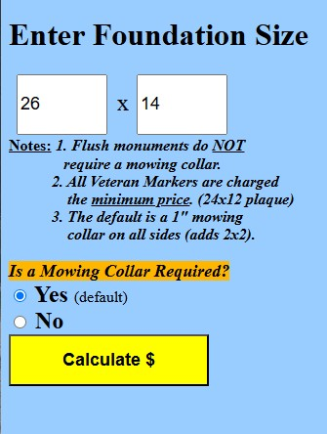
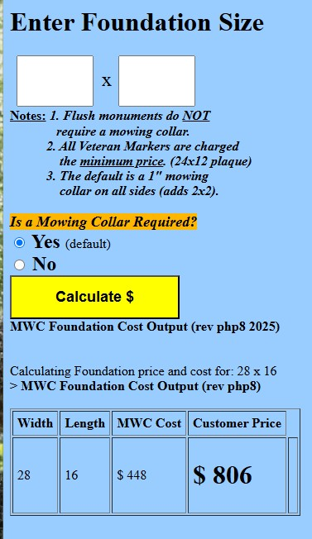
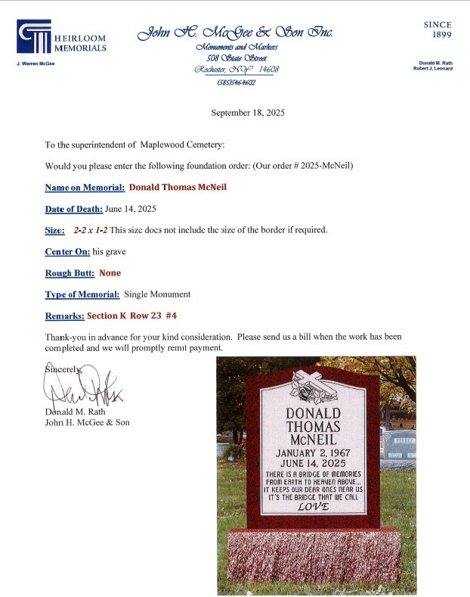
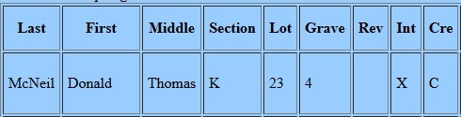
How are the foundation PRICE and COST calculated?
26x14 ordered
Add:
2x2 mowing collar
=28x16 foundation
Monument data also is entered in the ACCESS Database and tracked for completion.
Verify Location:

Slide 14
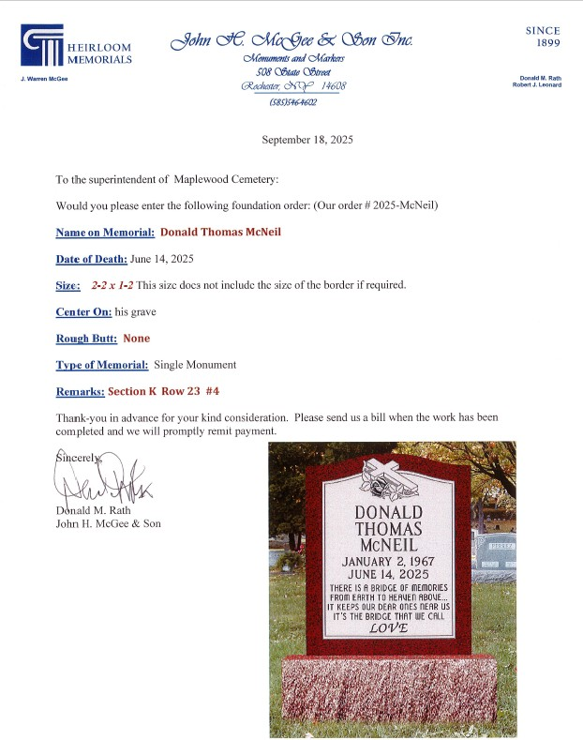
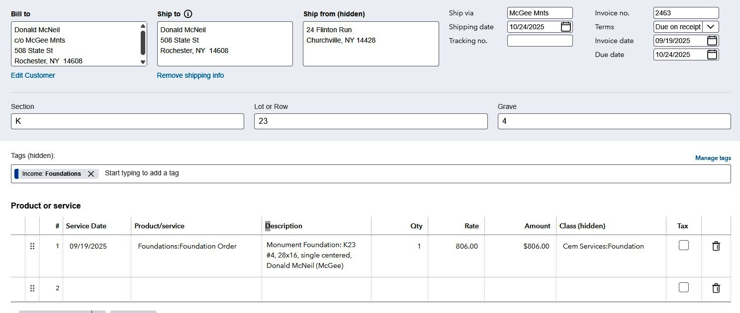
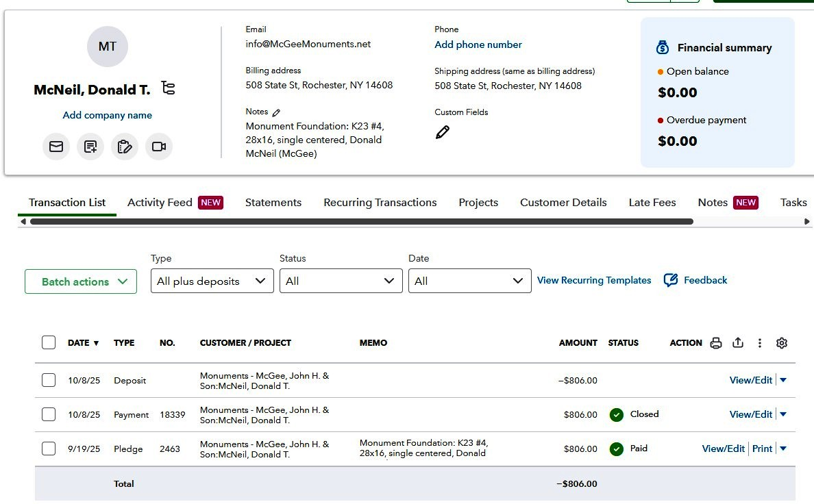
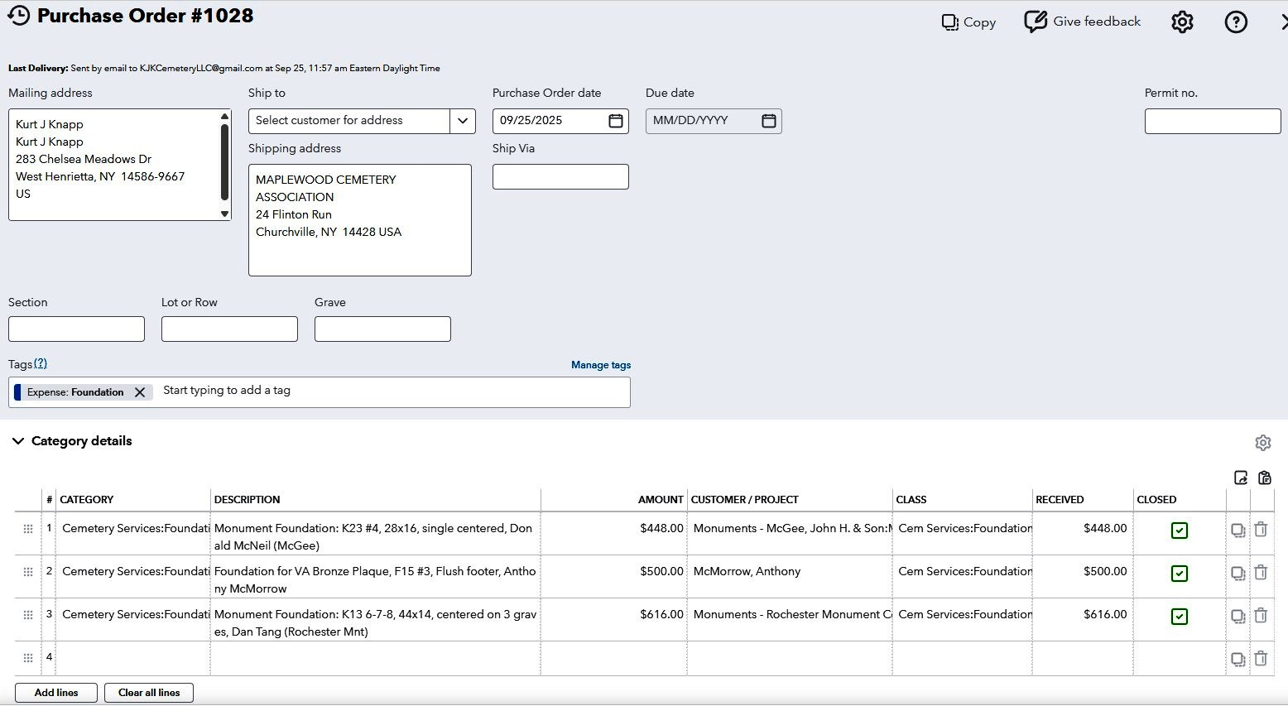
QBO Foundations
Verify that the grave is fully paid for first…..
$806
$448

Slide 15
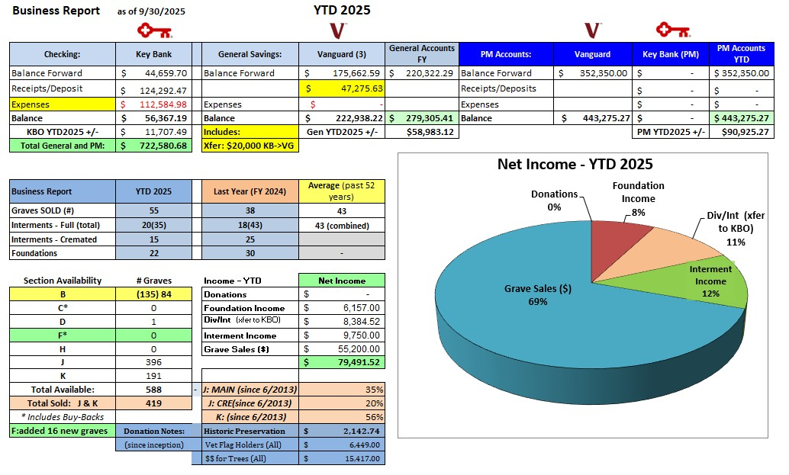
MWC Quarterly Business Report

Slide 16
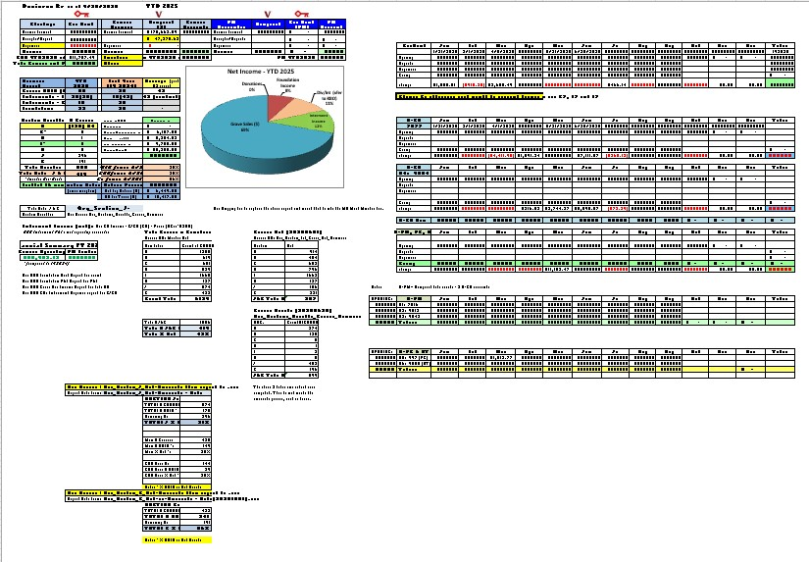
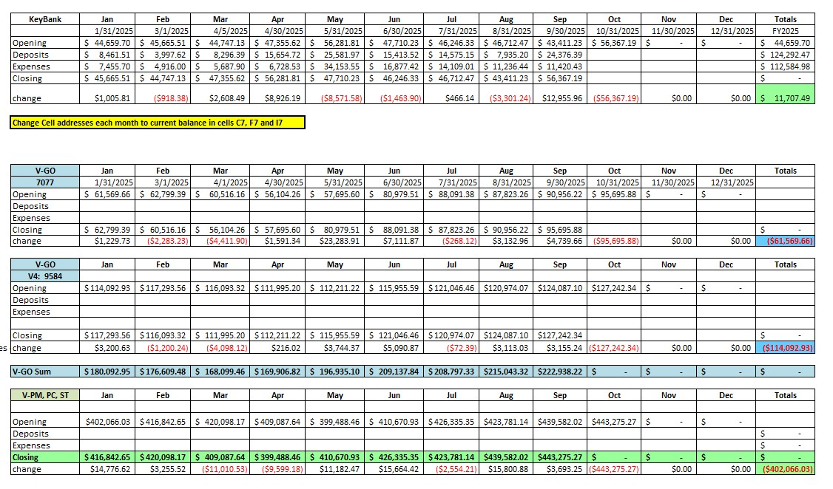
MWC Business Report

Slide 17
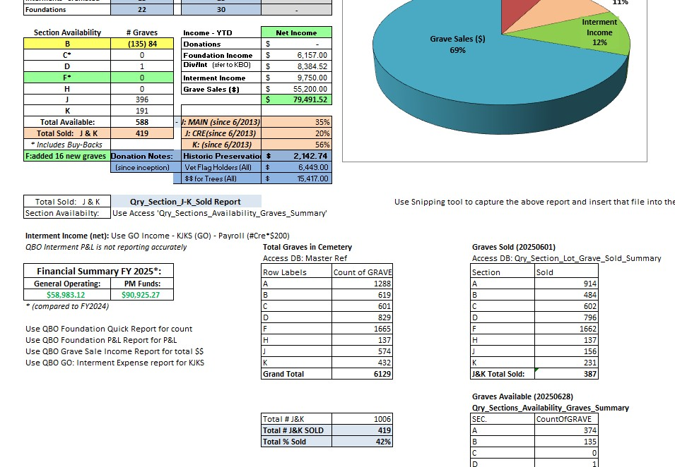
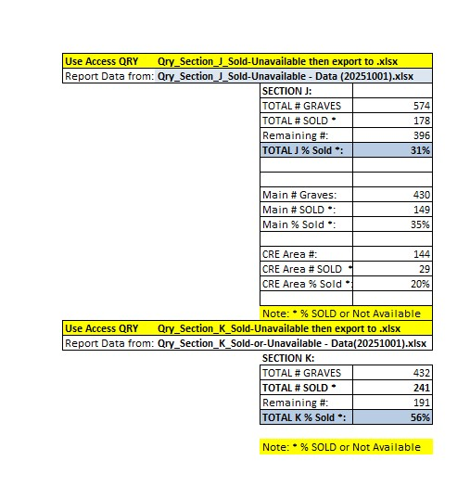
MWC Business Report
Note: Graves SOLD calculations are different than Grave SALES ($)

Slide 18
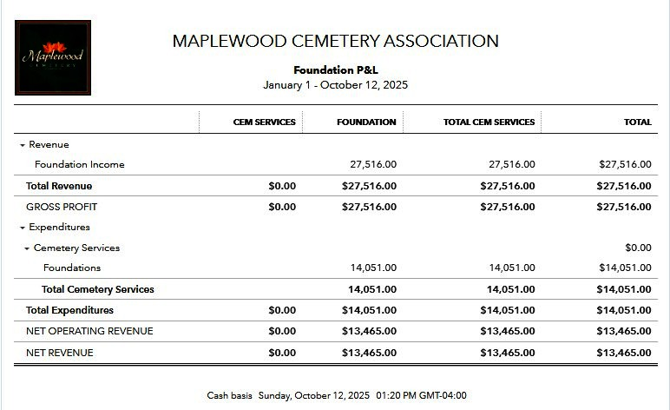
QBO provides P&L Reports

Slide 19
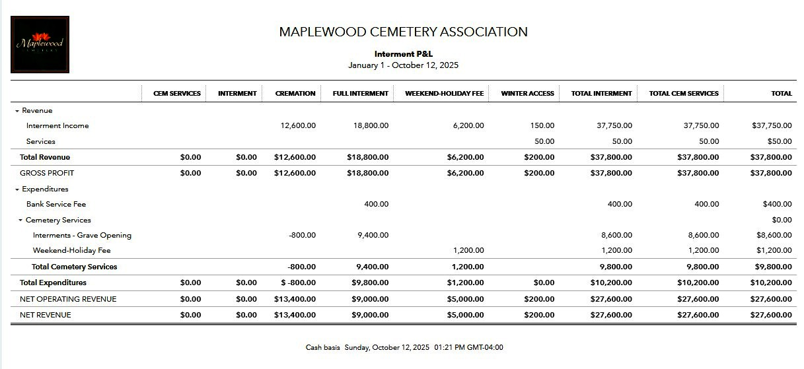
QBO provides P&L Reports

Slide 20
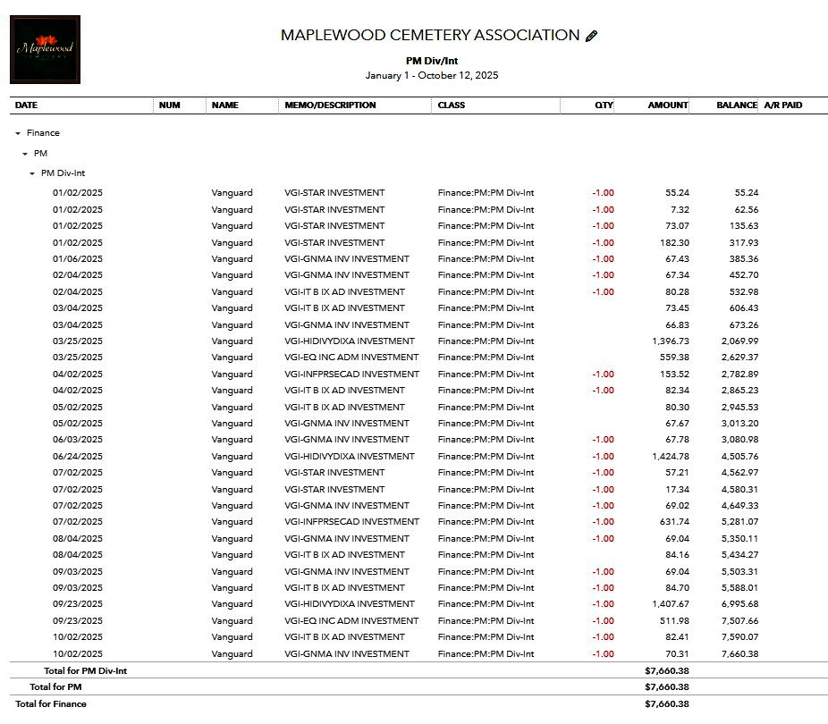
QBO
PM Div/Int report

Slide 21
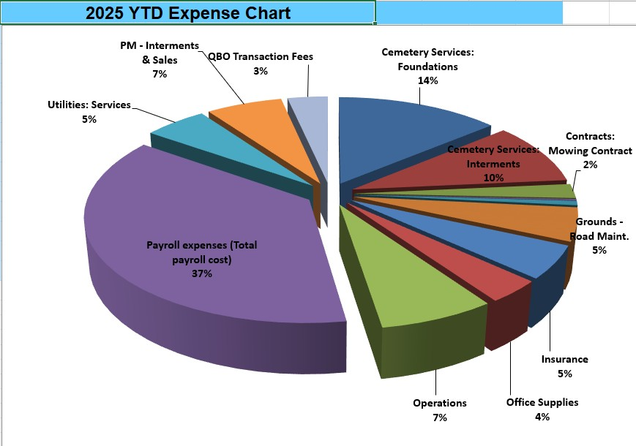
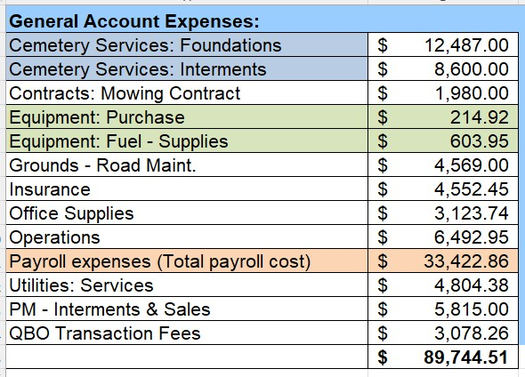
MWC Quarterly Business Report - Expenses

Slide 22
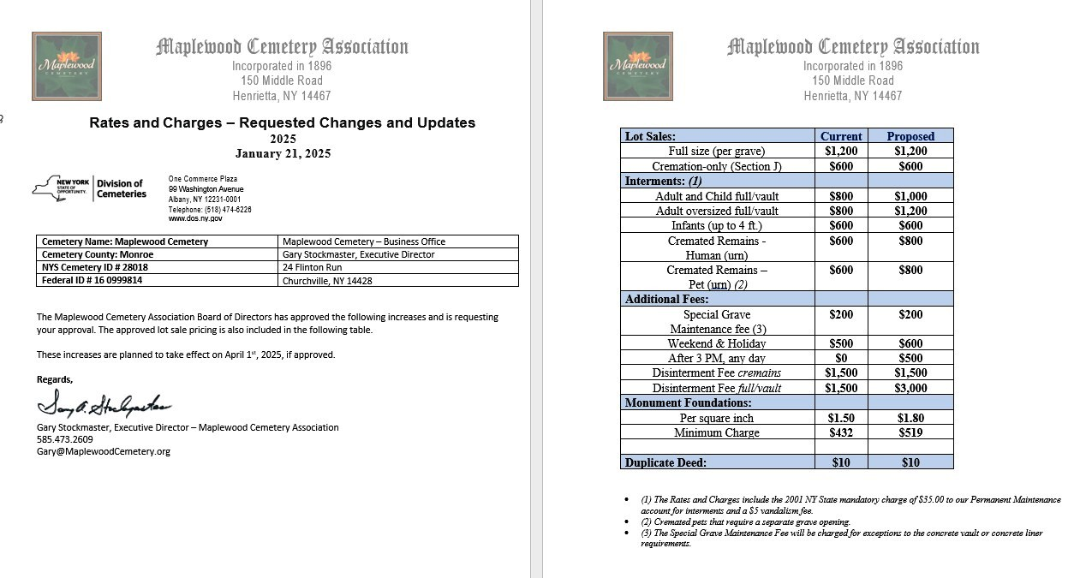
Rate change requests have to be submitted and approved by the NYS Cemetery Division

Slide 23
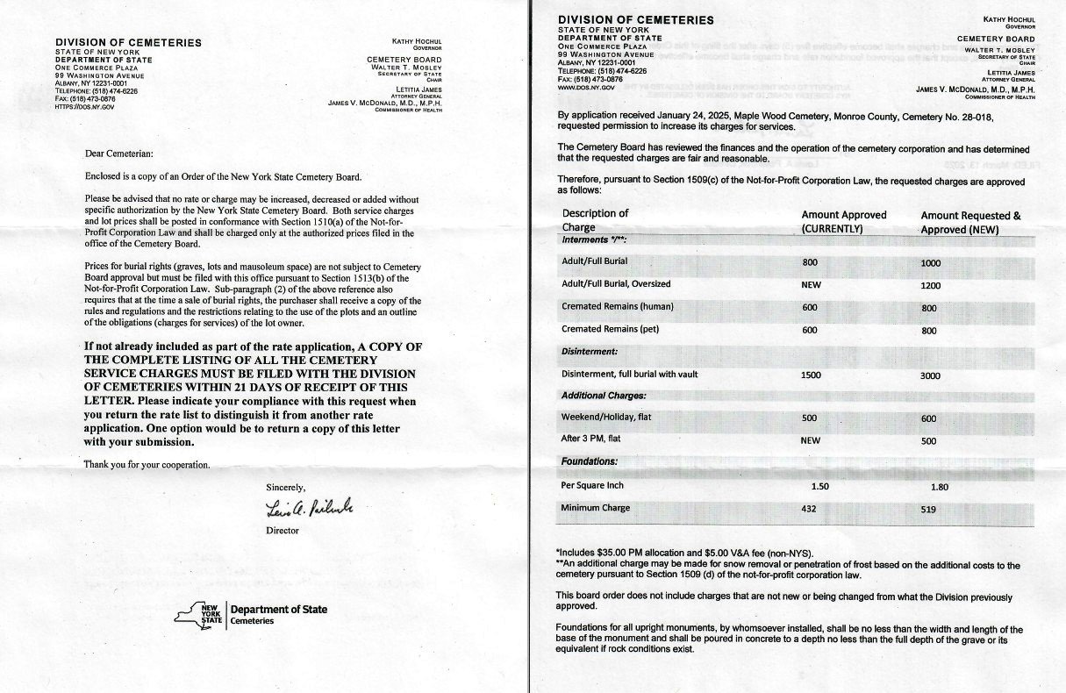
Rate change requests have to be submitted and approved by the NYS Cemetery Division
Rate changes requests are permitted once per year.

Slide 24
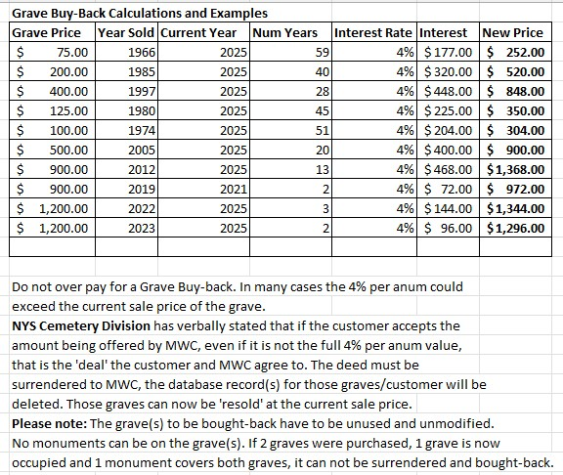
Grave Buy-Back Considerations
MWC is not required to buy-back any grave.
The NYS rules are more guidelines when the situation arises.
For instance, the table shows that if we strictly followed the NYS guidelines, we could potentially pay out more than the grave’s current sale price.
Buying back a grave can help both the requesting family and the cemetery.
Most surrounding cemeteries will NOT buy back graves.
Watch for deed ownership issues. A deceased deed owner can lead to family conflicts. These conflicts must be resolved, in writing, before we consider a buy back offer.
My preferred approach is to offer the amount it was initially sold for. There is some bargaining room but most families have agreed to that amount.
We can resell the grave at today’s price.

Slide 25


Planning and Forecasting
Planning and forecasting this business is difficult.
The table below was generated as a ‘proforma’ attempt to see what the business would have to accomplish to reverse the downward signs.
We can’t necessarily increase sales on demand, but we can identify cost cutting methods, such as delaying development projects or buying new equipment.
Future planning and forecasting for new developments has to be properly targeted. The development of new sections can take years to plan, permit and execute.

Slide 26
All that review and analysis leads to this:

