Slide 1
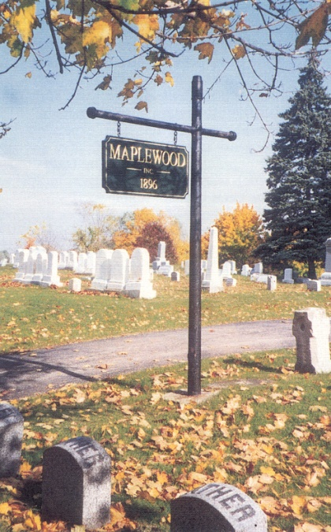

Welcome to the
126th Annual Meeting of the
Maplewood Cemetery Association

Slide 2

Welcome to the
126th Annual Meeting of the
Maplewood Cemetery Association
March 1, 2023

Slide 3


About Us….
Maplewood Cemetery is owned and operated by the Maplewood Cemetery Association which was incorporated in 1896 as a NY Cemetery Corporation.
Maplewood Cemetery is a not-for-profit, volunteer run, charitable organization made up of member-owners elected to the Association Board of Directors. The Board of Directors manages the cemetery corporation, appoints a superintendent, elects Officers for various functions and positions to make sure the cemetery grounds and business is properly operated, maintained and meets all of the required NY state and Federal regulations for cemeteries and non-profit corporations.
Maplewood Cemetery Association is closely regulated, audited and inspected by the N.Y.S. Division of Cemeteries and operates in the public interest rather than as a profit-making venture.
Maplewood Cemetery is also a member of the N.Y. State Association of Cemeteries which is dedicated to the furtherance of effective cemetery management and operation for better community service.

Slide 4
CEMETERY REGULATION IN NEW YORK STATE
New York is the most populous of the six states (including, Connecticut, Massachusetts, Maine, New Jersey, and Wyoming) in which cemeteries are required to be operated only on a non-profit basis. New York State's historical not for profit cemetery structure "for the mutual benefit of plot owners therein" is based upon the following aims:
to protect the well-being of its citizens;
to promote the public welfare;
to prevent cemeteries from falling into disrepair and dilapidation; and
to prevent cemeteries from becoming a burden upon the community. "for the mutual benefit of plot owners therein." Not-for-Profit Corporation Law (N-PCL) §1501.
In 1847 New York passed its first general law "authorizing the incorporation of rural cemetery associations." Over the next 100 years, many provisions were added relative to cemetery associations or corporations, resulting in the Membership Corporations Law (MCL) Article 9 (sections 70-105). This portion of the MCL was repealed and replaced with no change in form or substance by N-PCL §1401, effective in 1970. In 1977 N-PCL §1401, with all its myriad subdivisions, was enacted into current N-PCL Article 15 (sections 1501-1515).
The New York State Cemetery Board was created by statute in 1949 following a 1949 Report of the Attorney General, which was a study of operations and financial activities harmful to cemeteries.

Slide 5
The Division of Cemeteries and the New York State Cemetery Board regulate only those cemeteries that are incorporated under the Not-for-Profit Corporation Law.
Cemeteries that do not fall under our jurisdiction include religious, municipal, private, national and family cemeteries.
The Cemetery Board oversees the Division of Cemeteries' operations and administers the New York State Cemetery Law. The Cemetery Law sets standards for the establishment, maintenance, and preservation of burial grounds in New York State.
The Cemetery Board is made up of the New York State Secretary of State, the New York State Attorney General and the New York State Commissioner of Health.

Slide 6

Welcome to the
126th Annual Meeting of the
Maplewood Cemetery Association
Meeting Agenda:
Secretary – Read minutes from 2022 Annual Meeting
Treasurer – Business report for FY2022
Finance – Investment report for FY2022
Superintendent – Operations report
Grounds – Grounds status and activities
Sunshine – Report of events
Nominating – Review upcoming Board terms, changes and openings
Web and Database - status and updates
Donations –Program review
New Business - Projects, Discussions, Next Steps
General Discussions – Feedback, Issues
March 1, 2023

Slide 7
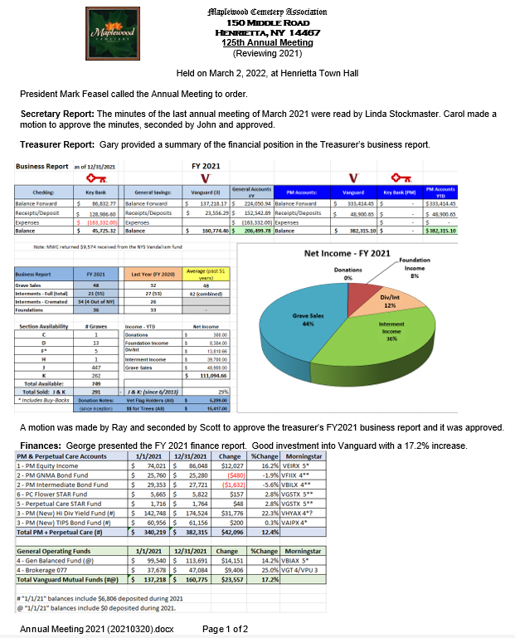
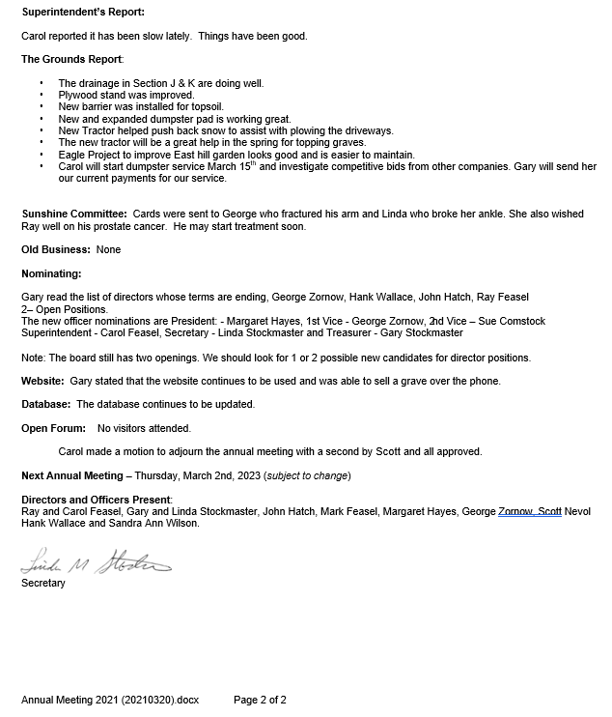

Slide 8

Welcome to the
126th Annual Meeting of the
Maplewood Cemetery Association
Meeting Agenda:
Secretary – Read minutes from FY2022 Annual Meeting
Treasurer – Business report for FY2022
Finance – Investment report for FY2022
Superintendent – Operations report
Grounds – Grounds status and activities
Sunshine – Report of events
Nominating – Review upcoming Board terms, changes and openings
Web and Database - status and updates
Donations –Program review
New Business - Projects, Discussions, Next Steps
General Discussions – Feedback, Issues
March 1, 2023

Slide 9
Maplewood Cemetery Association – 2023 Annual Meeting
Business Report - Reviewing 2022
2022 by the Numbers
Sections J & K are now 10 years old
  335 Graves sold in J & K so far (33%)
2022 Grave Sales: 25
Total Interments: 44
  Interments - Full Burial: 16
  Interments - Cremated: 28
  Pets: 0
New Monuments & Foundations: 19
3 Available Graves in Section F
  Section F unused graves are being purchased and resold
Cemetery Voicemail call volume: 275 calls

Slide 10
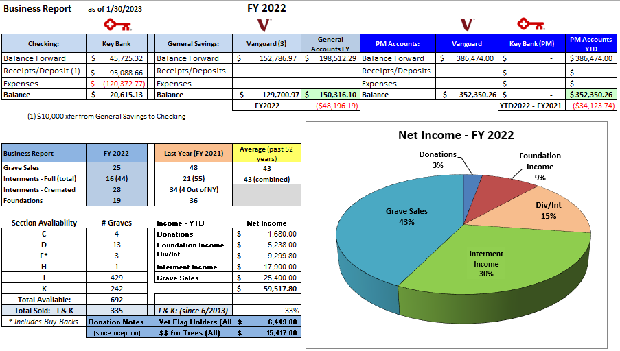
Maplewood Cemetery Association – 2023 Annual Meeting

Slide 11
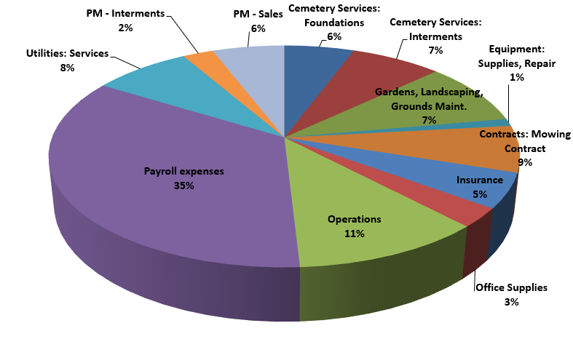
Maplewood Cemetery Association – 2023 Annual Meeting
Business Report - Reviewing 2022 – Major Expense Categories

Slide 12
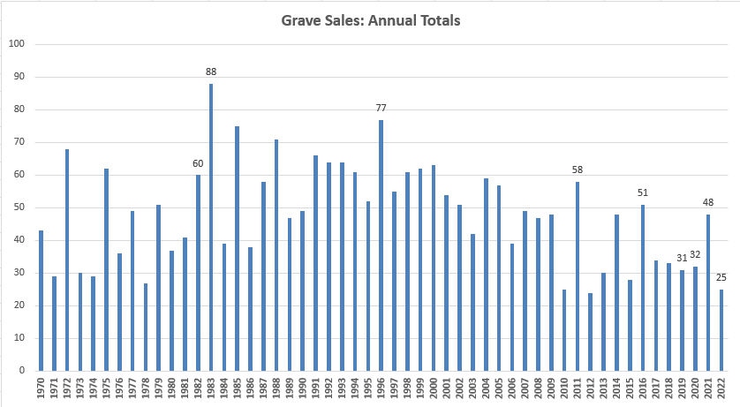
Maplewood Cemetery Association – 2023 Annual Meeting
Notes:
See MWC Annual Grave Sales and Interments 1968-2018 (20190221) in the Reports and Findings folder

Slide 13
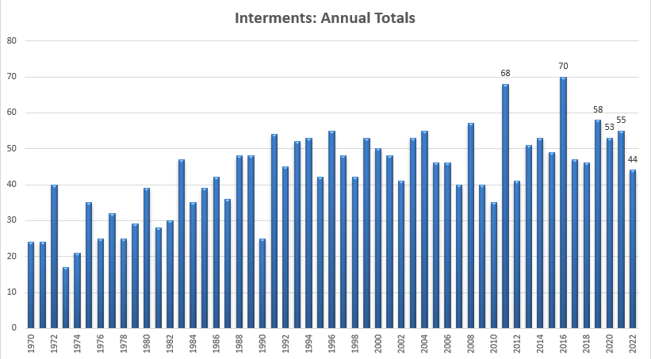
Maplewood Cemetery Association – 2023 Annual Meeting
Notes:
See MWC Annual Grave Sales and Interments 1968-2018 (20190221) in the Reports and Findings folder

Slide 14
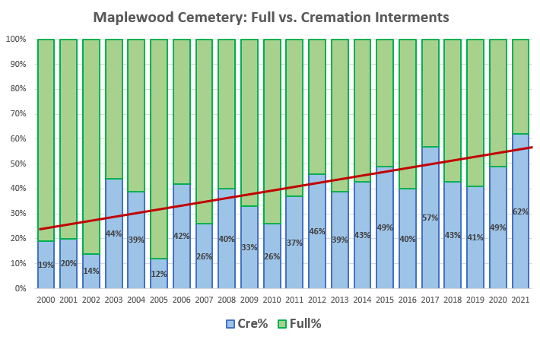
Maplewood Cemetery Association – 2023 Annual Meeting
National Cremation Averages
Notes:
See MWC Annual Grave Sales and Interments 1968-2019 (20200302) in the Reports and Findings folder

Slide 15

Welcome to the
126thAnnual Meeting of the
Maplewood Cemetery Association
Meeting Agenda:
Introduction – About Us and NY Cemetery Law
Secretary – Read minutes from 2022 Annual Meeting
Treasurer – Business report for FY2022
Finance – Investment report for FY2022
Superintendent – Operations report
Grounds – Grounds status and activities
Sunshine – Report of events
Nominating – Review upcoming Board terms, changes and openings
Web and Database - status and updates
Donations –Program review
New Business - Projects, Discussions, Next Steps
General Discussions – Feedback, Issues
March 1, 2023

Slide 16
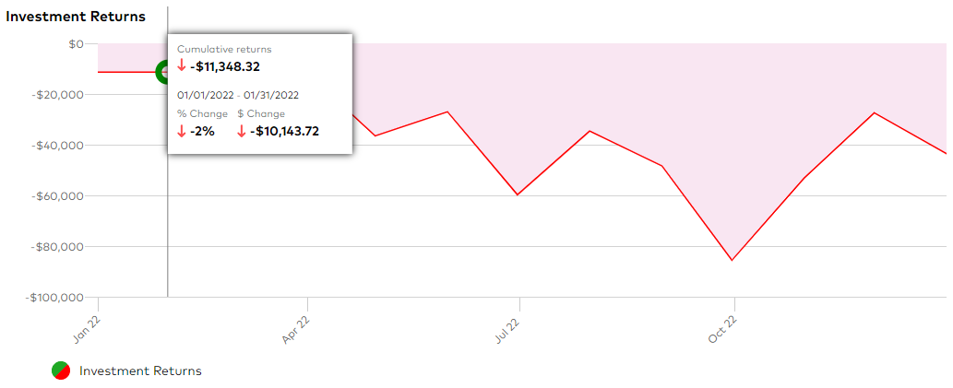
Maplewood Cemetery Association – 2023 Annual Meeting
Finance Report - Reviewing 2022 – Investment Year Performance

Slide 17
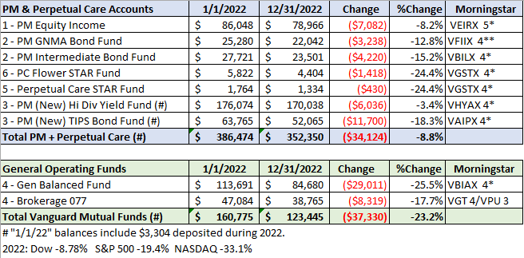
Maplewood Cemetery Association – 2023 Annual Meeting
Finance Report - Reviewing 2022 – Investment Year Performance

Slide 18
Reports:
Superintendent
Sunshine
Grounds
Nominating
Web and Data Base
Donations

Slide 19
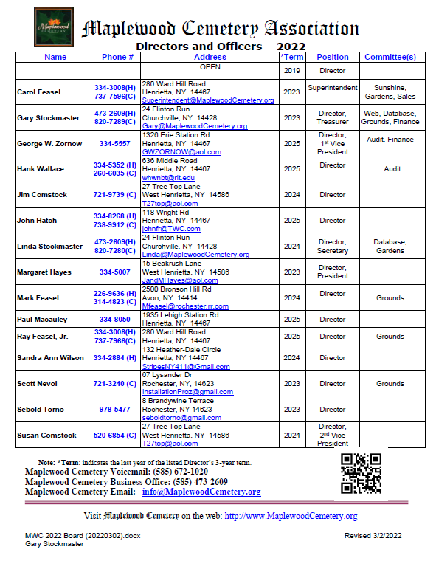
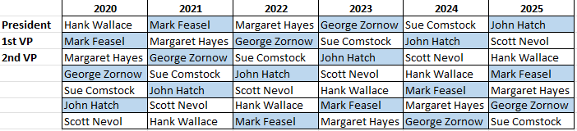
Maplewood Cemetery Association
2023 Annual Meeting – Nominating: Officers & Directors
Officers: (1 Year Term)
President
1st Vice President
2nd Vice President
Superintendent
Secretary
Treasurer
Directors: (3 Year Term)
Gary Stockmaster
Carol Feasel
Margaret Hayes
Scott Nevol
1 – Open Position
Leadership Rotation Schedule:

Slide 20

Web Site & Database

Slide 21
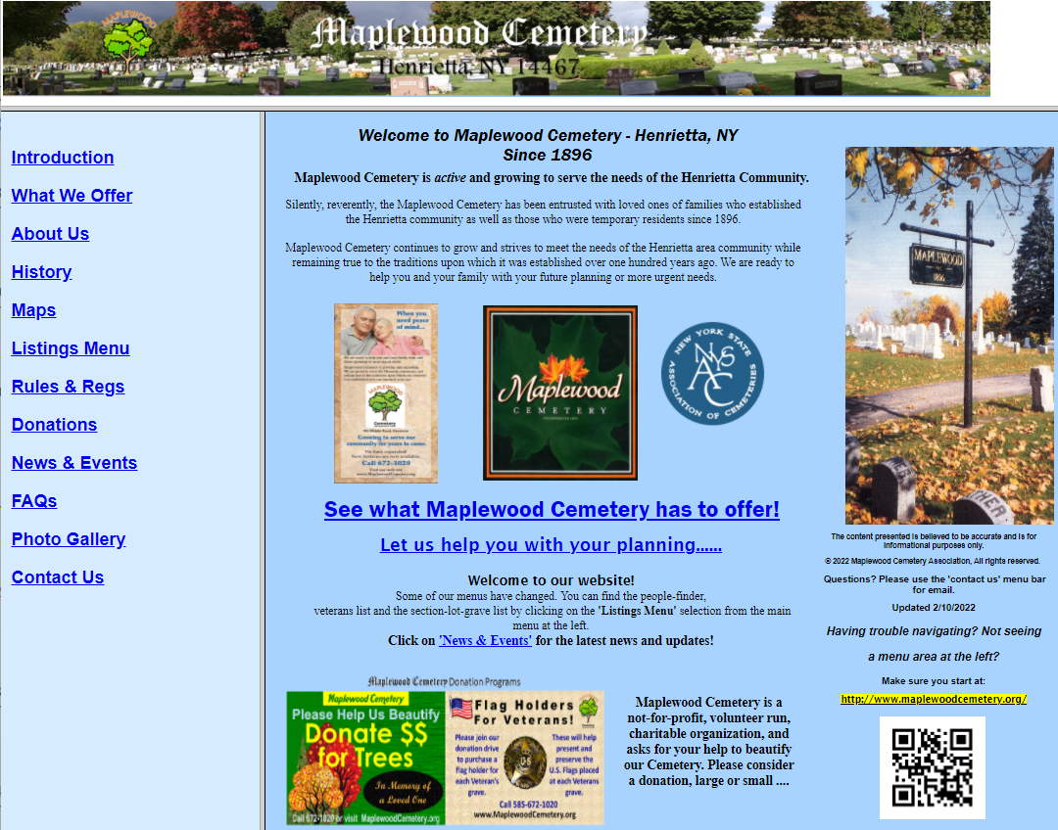
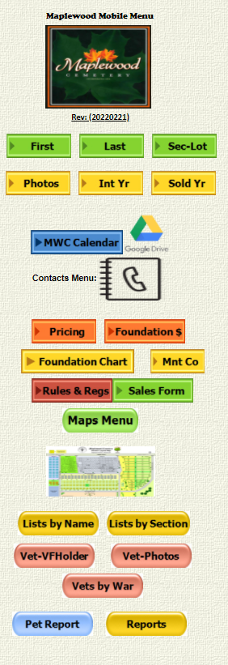

Slide 22
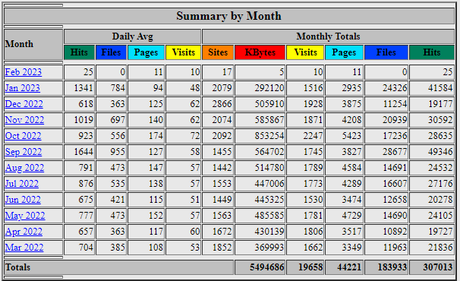
Maplewood Cemetery Association – 2023 Annual Meeting
Web Site Traffic

Slide 23
New Business
General Discussion

Slide 24

Thank you for attending the
126th Annual Meeting of the
Maplewood Cemetery Association

Slide 25
Welcome to the
1Q 2023 Directors Meeting of the
Maplewood Cemetery Association
March 1, 2023

Slide 26
Maplewood Cemetery Association
1Q 2023 Directors Meeting
Meeting Agenda:
Secretary – Read minutes from last meeting
Treasurer – Business report for 1Q 2023
Finance – Investment update for 1Q 2023 Superintendent – Operations update
Grounds – 1Q Grounds status and activities
Sunshine – Updates
Nominating – Elections of officers and directors
‘Old’ Business – review, discussion
New Business - Projects, Discussions, Next Steps
General Discussions – Feedback, Issues
March 1, 2023

Slide 27
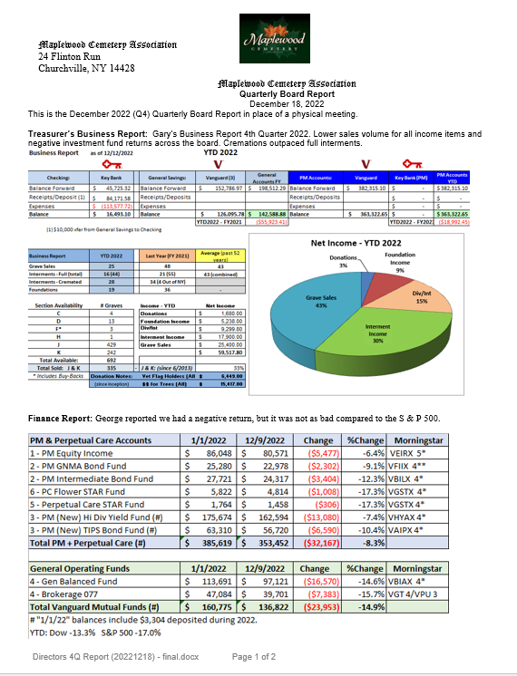
Maplewood Cemetery Association – 4Q 2022 Directors Meeting

Slide 28
Maplewood Cemetery Association
1Q 2023 Directors Meeting
Meeting Agenda:
Secretary – Read minutes from last meeting
Treasurer – Business report for 1Q 2023
Finance – Investment update for 1Q 2023 Superintendent – Operations update
Grounds – 1Q Grounds status and activities
Sunshine – Updates
Nominating – Elections of officers and directors
‘Old’ Business – review, discussion
New Business - Projects, Discussions, Next Steps
General Discussions – Feedback, Issues
March 1, 2023

Slide 29
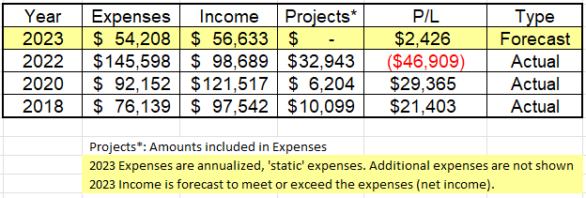
Maplewood Cemetery Association
1Q 2023 Directors Meeting
2023 Business Forecast:
What does it cost to ‘run’ the cemetery?
How much do we want to sell?

Slide 30
Maplewood Cemetery Association
1Q 2023 Directors Meeting
2022 Expenses:
What does it cost to ‘run’ the cemetery?

Slide 31
Maplewood Cemetery Association
1Q 2023 Directors Meeting
2023 Business Forecast:
What does it cost to ‘run’ the cemetery?

Slide 32
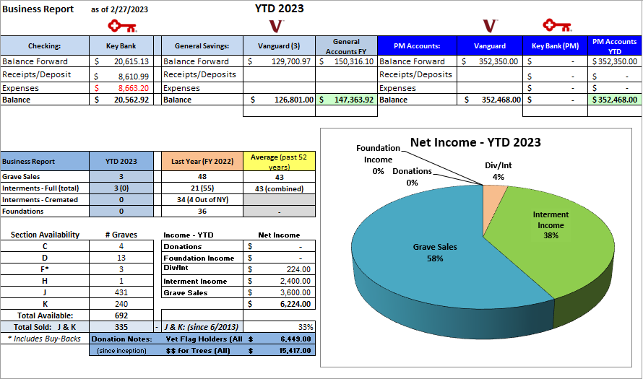
Maplewood Cemetery Association – 1Q 2023 Directors Meeting
YTD 2023 Business Report

Slide 33
Maplewood Cemetery Association
1Q 2023 Directors Meeting
Reports:
Finance
Superintendent
Grounds
Sunshine
Nominating

Slide 34
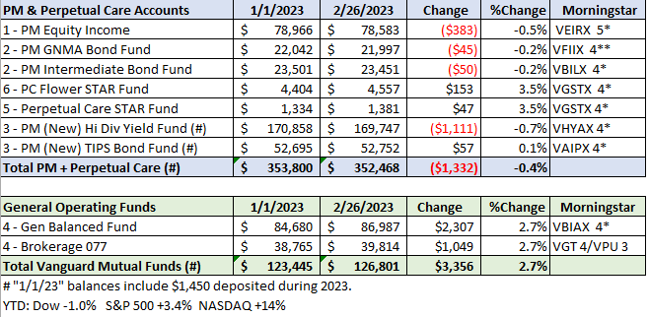
Maplewood Cemetery Association – 1Q 2023 Directors Meeting
Finance Report - YTD 2023 – Investment Performance

Slide 35
Maplewood Cemetery Association
1Q 2023 Directors Meeting
Reports:
Finance
Superintendent
Grounds
Sunshine

Slide 36
Maplewood Cemetery Association
1Q 2023 Directors Meeting
Reports:
Finance
Superintendent
Grounds
Sunshine
Nominating

Slide 37
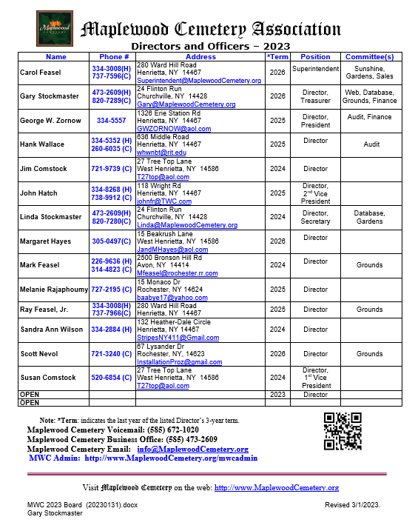
Maplewood Cemetery Association
1Q 2023 Directors Meeting – Nominating: Officers & Directors
Officers: (1 Year Term)
President:
George Zornow
1st Vice President:
Sue Comstock
2nd Vice President:
John Hatch
Superintendent:
Carol Feasel
Secretary:
Linda Stockmaster
Treasurer:
Gary Stockmaster
Directors: (3 Year Term)
Carol Feasel
Margaret Hayes
Scott Nevol
Gary Stockmaster
1 – Open Position
Leadership Rotation Schedule:

Slide 38
Maplewood Cemetery Association
1Q 2023 Directors Meeting
Old Business :
MWC By-Laws review. John recommends a committee of himself, Gary, Scott, George and Melanie work on the By-Laws and present their findings at the annual meeting. Margaret should also be invited. Gary agreed to host at his house and will setup to review meetings.
Some discussion was had about the salary we currently pay employees.
Scott has agreed to work with Carol to learn what she does as superintendent.
2022 Sales and revenues are lower than anticipated.

Slide 39
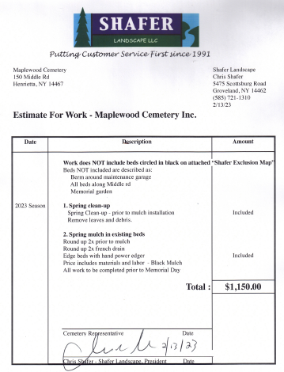
Maplewood Cemetery Association
1Q 2023 Directors Meeting
New Business:
Grounds – Gardens: Spring Cleanup renewal
  Proposal from Chris Shafer, $1,150
    Includes:
      Designated gardens
      All ‘new’ trees with a mulch border
    Spring Clean-up, remove leaves and debris
    Edge designated gardens and tree beds
    Mulch these garden and tree beds
    Price includes materials and labor
    All work to be completed prior to Memorial Day

Slide 40

Maplewood Cemetery Association
1Q 2023 Directors Meeting
New Business:
Grounds – Annual Landscape Maintenance renewal
  Proposal from Cardinal Landscape, $5,200
    Includes:
      Pruning of shrubs, weed, edge and mulch garage berm, front berms, Veterans garden and Memorial garden.
      Pruning 2/year, June & August
      Weeding monthly April - October
      Price includes materials and labor

Slide 41
Maplewood Cemetery Association
1Q 2023 Directors Meeting
Other New Business:

Slide 42
Maplewood Cemetery Association
1Q 2023 Directors Meeting
Other New Business:
Next Quarterly Board Meeting: Wednesday June 7th
At the Cemetery Shed

Slide 43
Thank You for attending the
1Q 2023 Directors Meeting of the
Maplewood Cemetery Association
March 1, 2023

Slide 44



Cemetery Operations:
Burial Scheduling
Vendor scheduling
Landscape & Grounds Management
  Mowing
  Trimming
  Grave topping & seeding
  Roads
Equipment Management
  Purchases
  Repairs
  Supplies
  Shed
  Tools
  Hydrants
Business Management of:
Sales transactions
Financial records
Inventory records and maps
Customer data
Employee payroll
Vendor transactions Federal and NY taxes and filings
Insurance contracts
Compliance with NYS & Cemetery Laws
Communications, marketing and social-public media, website
Infrastructure technology
Security requirements
Customers
Operations
Business
Board of Directors
Planning, Pricing, Rules & Regulations, Policies, Bylaws, Staffing, Audit

Slide 45
Current positions:
Secretary
Treasurer
No Finance Officer position
No backup for secretary or treasurer tasks
How will a new treasurer or secretary be brought in and trained?
Proposed Clarification and Changes:
Define tasks that could be assigned for a segment of the business.
Add a Business Manager position
    Coordinates all business activities
    Primary Sales Contact
    Trainer and Backup for other Business positions
  Secretary
    Sales Data Entry
    Inventory Management
    Deed management
  Treasurer
    Add ‘Vice’ treasurer
    Backup for Secretary
  Add Finance Officer
    Investment management
    Backup for treasurer (‘Vice Treasurer’)
  Add Infrastructure Management
    Webmaster
    Security
Business

Slide 46







Business Office
Customers
Vendors

Slide 47


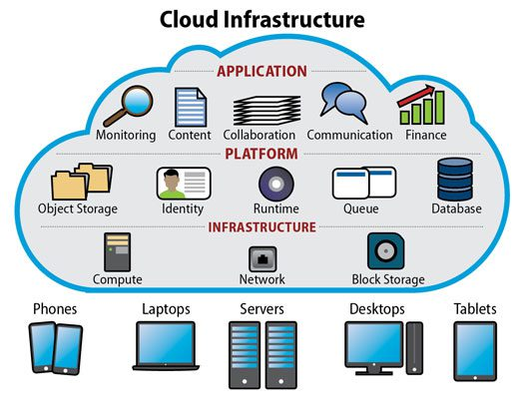







Finance
Banking
Payroll – direct deposit
Email – Bank Transfers
  Invoicing, A/R
  Bill Pay, A/P
  Customers
  Vendors
Records Management
Inventory
Audit
Communications
Collaboration
Data Security
Accessibility
Gallery
Security

