Slide 1
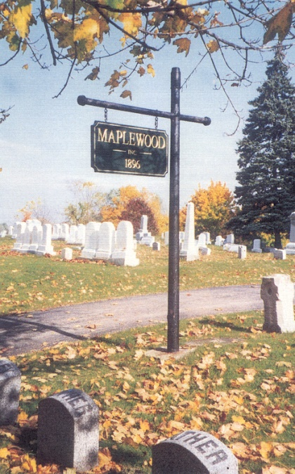
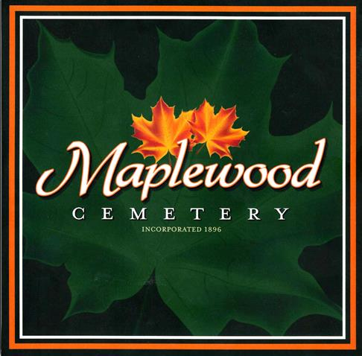
Welcome to the
124th Annual Meeting of the
Maplewood Cemetery Association

Slide 2

Welcome to the
124th Annual Meeting of the
Maplewood Cemetery Association
March 2, 2022

Slide 3


About Us….
Maplewood Cemetery is owned and operated by the Maplewood Cemetery Association which was incorporated in 1896 as a NY Cemetery Corporation.
Maplewood Cemetery is a not-for-profit, volunteer run, charitable organization made up of member-owners elected to the Association Board of Directors. The Board of Directors manages the cemetery corporation, appoints a superintendent, elects Officers for various functions and positions to make sure the cemetery grounds and business is properly operated, maintained and meets all of the required NY state and Federal regulations for cemeteries and non-profit corporations.
Maplewood Cemetery Association is closely regulated, audited and inspected by the N.Y.S. Division of Cemeteries and operates in the public interest rather than as a profit-making venture.
Maplewood Cemetery is also a member of the N.Y. State Association of Cemeteries which is dedicated to the furtherance of effective cemetery management and operation for better community service.

Slide 4
CEMETERY REGULATION IN NEW YORK STATE
New York is the most populous of the six states (including, Connecticut, Massachusetts, Maine, New Jersey, and Wyoming) in which cemeteries are required to be operated only on a non-profit basis. New York State's historical not for profit cemetery structure "for the mutual benefit of plot owners therein" is based upon the following aims:
to protect the well-being of its citizens;
to promote the public welfare;
to prevent cemeteries from falling into disrepair and dilapidation; and
to prevent cemeteries from becoming a burden upon the community. "for the mutual benefit of plot owners therein." Not-for-Profit Corporation Law (N-PCL) §1501.
In 1847 New York passed its first general law "authorizing the incorporation of rural cemetery associations." Over the next 100 years, many provisions were added relative to cemetery associations or corporations, resulting in the Membership Corporations Law (MCL) Article 9 (sections 70-105). This portion of the MCL was repealed and replaced with no change in form or substance by N-PCL §1401, effective in 1970. In 1977 N-PCL §1401, with all its myriad subdivisions, was enacted into current N-PCL Article 15 (sections 1501-1515).
The New York State Cemetery Board was created by statute in 1949 following a 1949 Report of the Attorney General, which was a study of operations and financial activities harmful to cemeteries.

Slide 5
The Division of Cemeteries and the New York State Cemetery Board regulate only those cemeteries that are incorporated under the Not-for-Profit Corporation Law.
Cemeteries that do not fall under our jurisdiction include religious, municipal, private, national and family cemeteries.
The Cemetery Board oversees the Division of Cemeteries' operations and administers the New York State Cemetery Law. The Cemetery Law sets standards for the establishment, maintenance, and preservation of burial grounds in New York State.
The Cemetery Board is made up of the New York State Secretary of State, the New York State Attorney General and the New York State Commissioner of Health.

Slide 6

Welcome to the
124th Annual Meeting of the
Maplewood Cemetery Association
Meeting Agenda:
Secretary – Read minutes from 2021 Annual Meeting
Treasurer – Business report for FY2021
Finance – Investment report for FY2021
Superintendent – Operations report
Grounds – Grounds status and activities
Sunshine – Report of events
Nominating – Review upcoming Board terms, changes and openings
Web and Database - status and updates
Donations –Program review
New Business - Projects, Discussions, Next Steps
General Discussions – Feedback, Issues
March 2, 2022

Slide 7
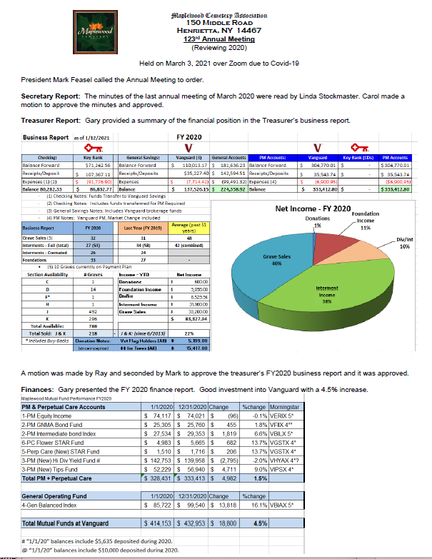
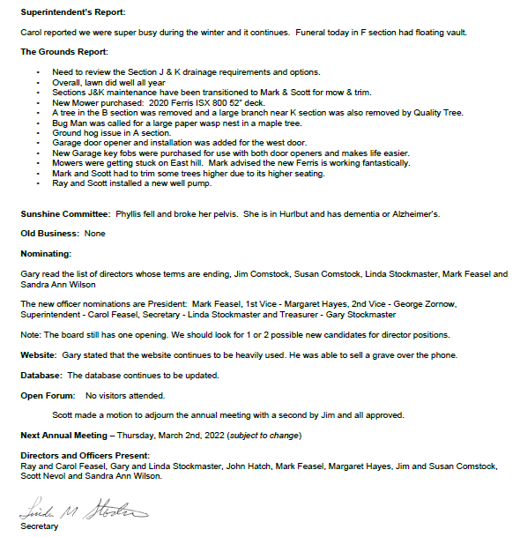

Slide 8

Welcome to the
124th Annual Meeting of the
Maplewood Cemetery Association
Meeting Agenda:
Secretary – Read minutes from FY2021 Annual Meeting
Treasurer – Business report for FY2021
Finance – Investment report for FY2021
Superintendent – Operations report
Grounds – Grounds status and activities
Sunshine – Report of events
Nominating – Review upcoming Board terms, changes and openings
Web and Database - status and updates
Donations –Program review
New Business - Projects, Discussions, Next Steps
General Discussions – Feedback, Issues
March 2, 2022

Slide 9
Maplewood Cemetery Association – 2022 Annual Meeting
Business Report - Reviewing 2021
2021 by the Numbers
Sections J & K are now 9 years old
  291 Graves sold in J & K so far (29%)
2021 Grave Sales: 48
Total Interments: 55
  Interments - Full Burial: 21
  Interments - Cremated: 34
  Pets: 4
New Monuments & Foundations: 36
5 Available Graves in Section F
  Section F unused graves are being purchased and resold

Slide 10
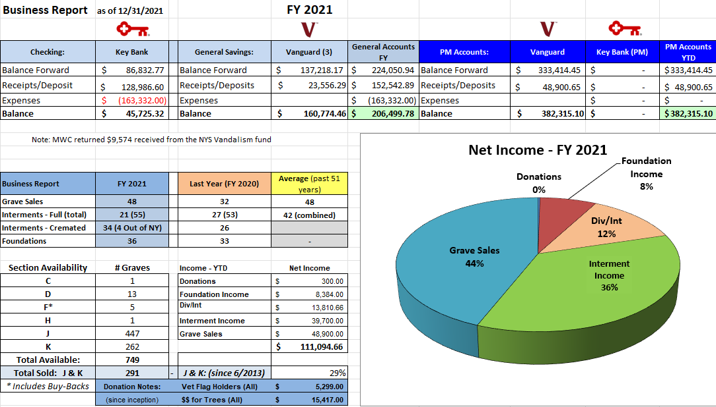
Maplewood Cemetery Association – 2022 Annual Meeting

Slide 11
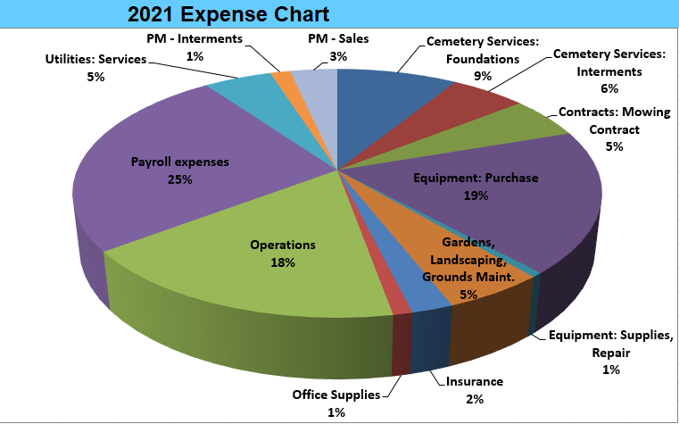
Maplewood Cemetery Association – 2022 Annual Meeting
Business Report - Reviewing 2021 – Major Expense Categories

Slide 12

Maplewood Cemetery Association – 2022 Annual Meeting
Business Report - Reviewing 2021
Business Report: Details
Maplewood Cemetery had a few large expenses the last half of 2021.
John Deere Tractor: $24,257.55
Mason Trenching Co.: Sections J&K drainage project: $12,500
Cardinal Lawn & Landscape: Shrub trimming, Lawn soil repair: $5,410.00
Ruston Paving Co.: Road repair, shed ramp paving and dumpster pad extension: $16,417.00
NYS Division of Cemeteries: Return of vandalism funds: $9,574.00
  Total of these projects: $68,158.55

Slide 13
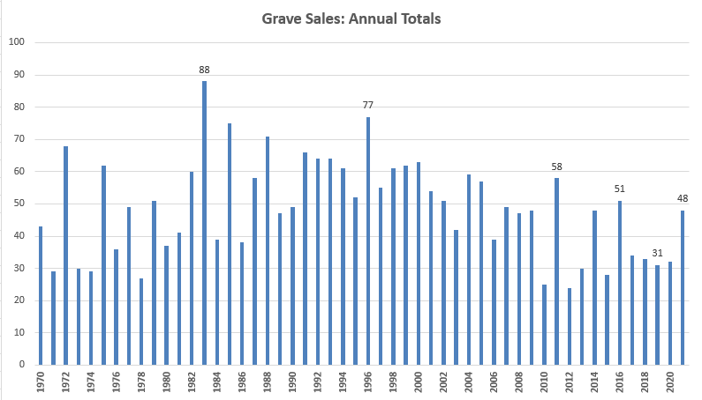
Maplewood Cemetery Association – 2022 Annual Meeting
Notes:
See MWC Annual Grave Sales and Interments 1968-2018 (20190221) in the Reports and Findings folder

Slide 14
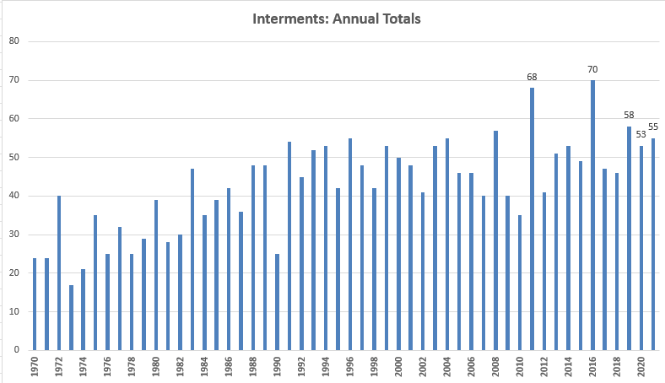
Maplewood Cemetery Association – 2022 Annual Meeting
Notes:
See MWC Annual Grave Sales and Interments 1968-2018 (20190221) in the Reports and Findings folder

Slide 15
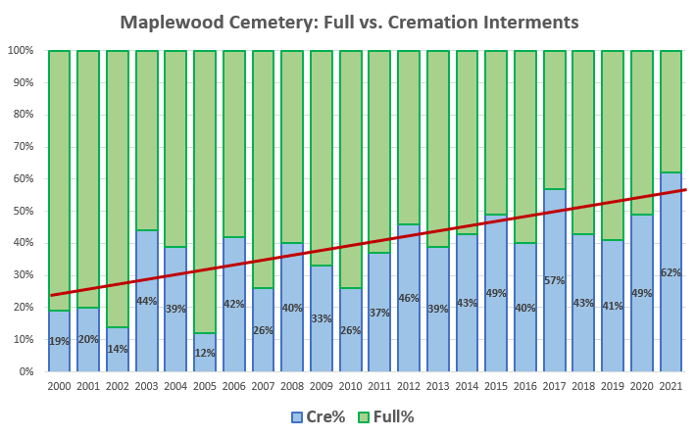
Maplewood Cemetery Association – 2022 Annual Meeting
National Cremation Averages
Notes:
See MWC Annual Grave Sales and Interments 1968-2019 (20200302) in the Reports and Findings folder

Slide 16

Welcome to the
124thAnnual Meeting of the
Maplewood Cemetery Association
Meeting Agenda:
Introduction – About Us and NY Cemetery Law
Secretary – Read minutes from 2021 Annual Meeting
Treasurer – Business report for FY2021
Finance – Investment report for FY2021
Superintendent – Operations report
Grounds – Grounds status and activities
Sunshine – Report of events
Nominating – Review upcoming Board terms, changes and openings
Web and Database - status and updates
Donations –Program review
New Business - Projects, Discussions, Next Steps
General Discussions – Feedback, Issues
March 2, 2022

Slide 17
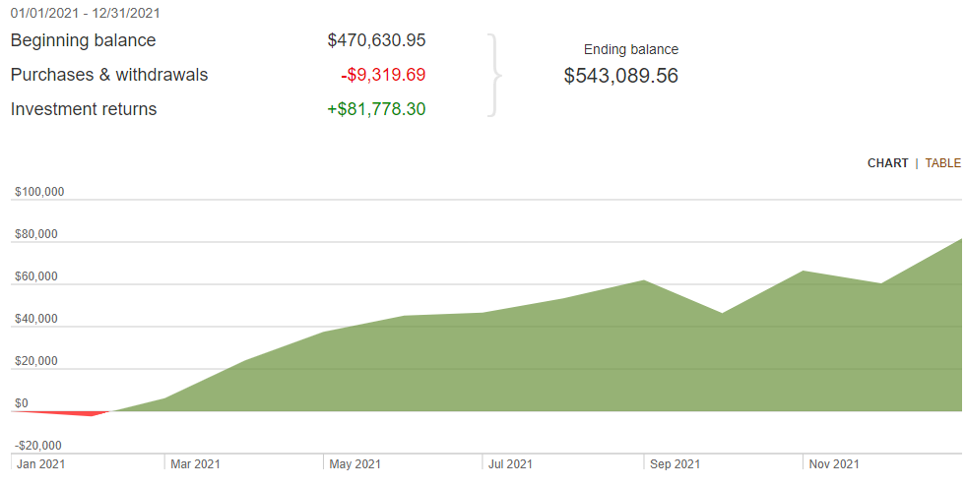
Maplewood Cemetery Association – 2022 Annual Meeting
Finance Report - Reviewing 2021 – 1 Investment Year Performance

Slide 18
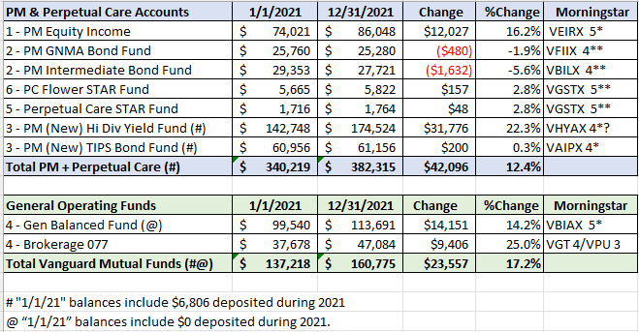
Maplewood Cemetery Association – 2022 Annual Meeting
Finance Report - Reviewing 2021 – Investment Year Performance

Slide 19
Reports:
Superintendent
Sunshine
Grounds
Nominating
Web and Data Base
Donations

Slide 20
2021 – Grounds Report
John Deere Tractor: $24,257.55
Mason Trenching Co.: Sections J&K drainage project: $12,500
Cardinal Lawn & Landscape: Shrub trimming, Lawn soil repair: $5,410.00
Ruston Paving Co.: Road repair, shed ramp paving and dumpster pad extension: $16,417.00
TruGreen delivered 2 weed and feed treatments. Weeds remain under control.

Slide 21
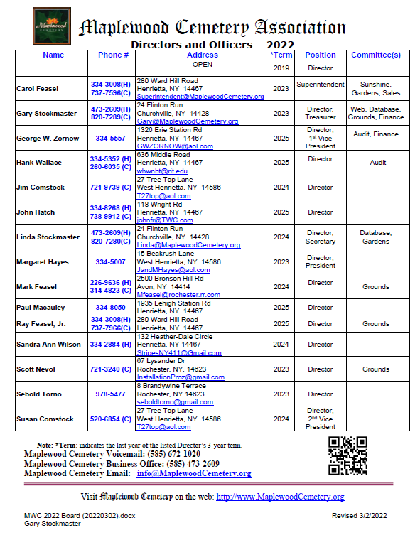
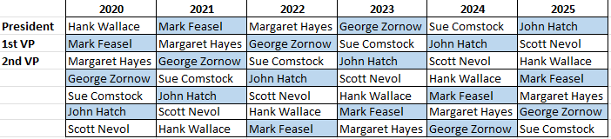
Maplewood Cemetery Association
2022 Annual Meeting – Nominating: Officers & Directors
Officers: (1 Year Term)
President
1st Vice President
2nd Vice President
Superintendent
Secretary
Treasurer
Directors: (3 Year Term)
George Zornow
Hank Wallace
John Hatch
Paul Macauley
Ray Feasel
1 – Open Position
Leadership Rotation Schedule:

Slide 22

Web Site & Database

Slide 23
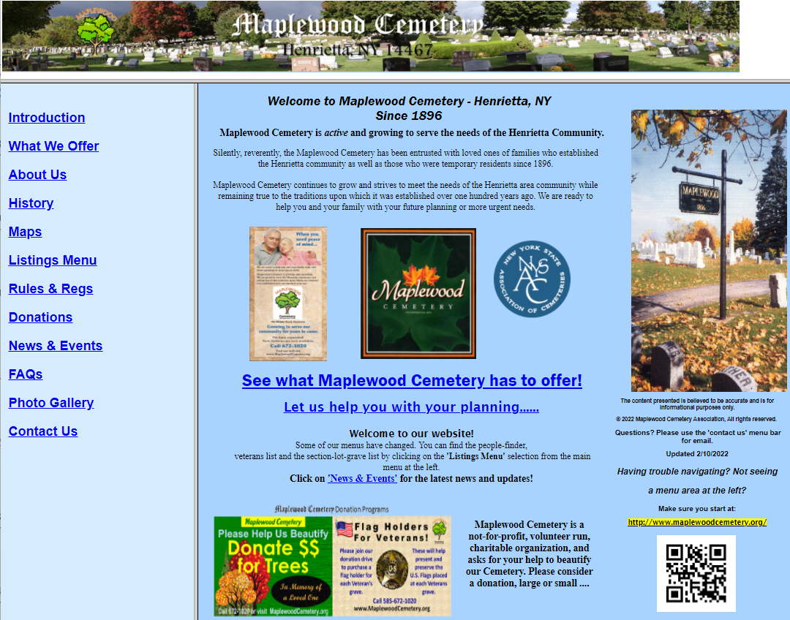
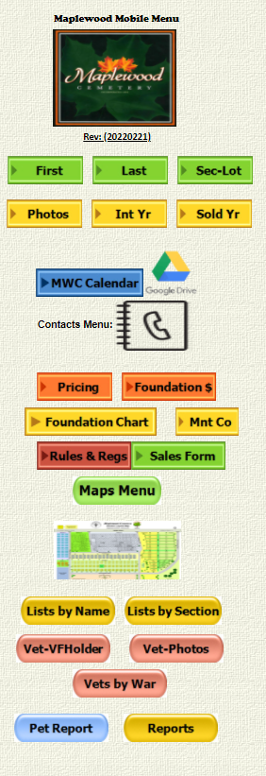

Slide 24


Maplewood Cemetery Association – 2022 Annual Meeting
Donation Programs

Slide 25
New Business
General Discussion

Slide 26

Thank you for attending the
124th Annual Meeting of the
Maplewood Cemetery Association

Slide 27
Welcome to the
1Q 2022 Directors Meeting of the
Maplewood Cemetery Association
March 2, 2022

Slide 28
Maplewood Cemetery Association
1Q 2022 Directors Meeting
Meeting Agenda:
Secretary – Read minutes from last meeting
Treasurer – Business report for 1Q 2022
Finance – Investment update for 1Q 2022 Superintendent – Operations update
Grounds – 1Q Grounds status and activities
Sunshine – Updates
Nominating – Elections of officers and directors
Web and Database - Updates
Donations – Updates
‘Old’ Business – review, discussion
New Business - Projects, Discussions, Next Steps
General Discussions – Feedback, Issues
March 2, 2022

Slide 29
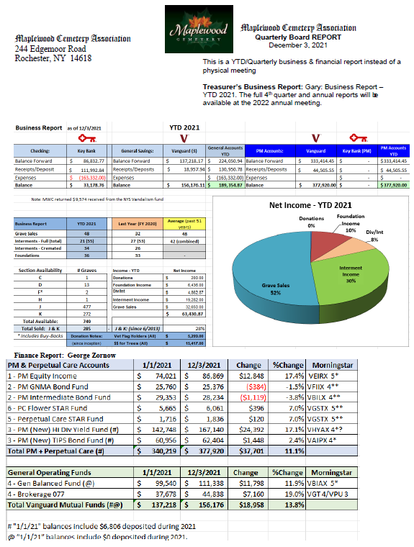
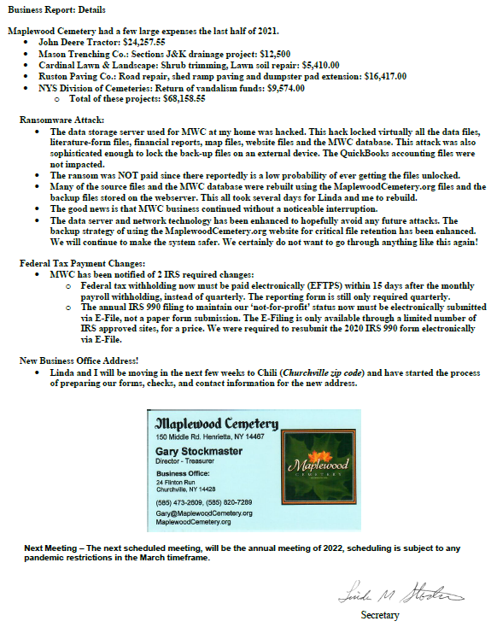

Slide 30
Maplewood Cemetery Association
1Q 2022 Directors Meeting
Meeting Agenda:
Secretary – Read minutes from last meeting
Treasurer – Business report for 1Q 2022
Finance – Investment update for 1Q 2022 Superintendent – Operations update
Grounds – 1Q Grounds status and activities
Sunshine – Updates
Nominating – Elections of officers and directors
Web and Database - Updates
Donations – Updates
‘Old’ Business – review, discussion
New Business - Projects, Discussions, Next Steps
General Discussions – Feedback, Issues
March 2, 2022

Slide 31
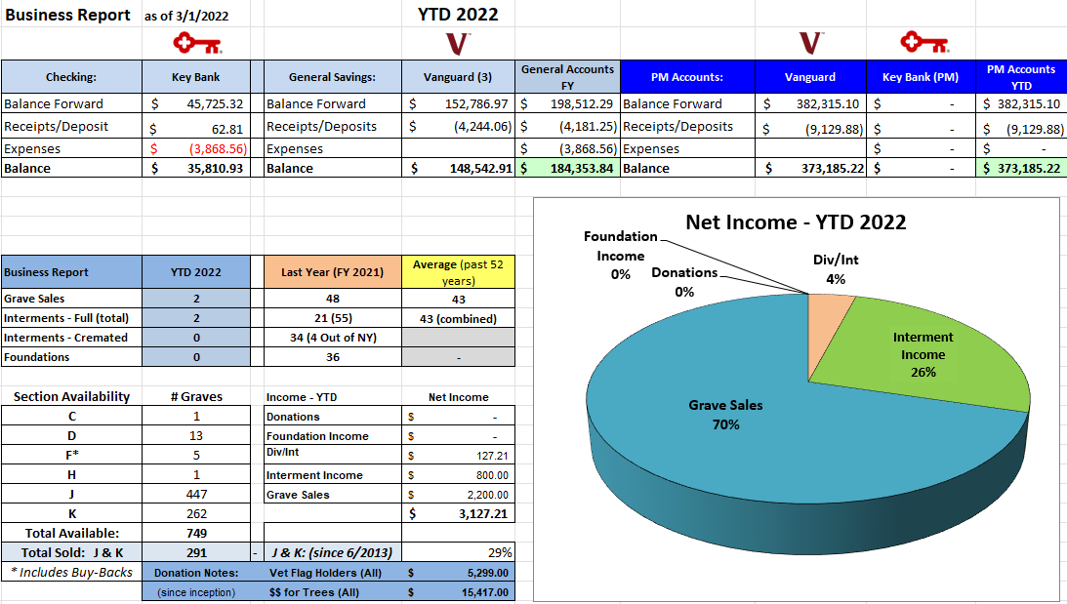
Maplewood Cemetery Association – 1Q 2022 Directors Meeting
YTD 2022 Business Report

Slide 32
Maplewood Cemetery Association
1Q 2022 Directors Meeting
Reports:
Finance
Superintendent
Grounds
Sunshine
Nominating
Web and Data Base
Donations

Slide 33
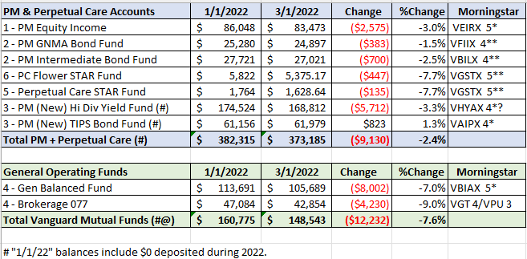
Maplewood Cemetery Association – 2022 Annual Meeting
Finance Report - YTD 2022 – Investment Year Performance

Slide 34
Maplewood Cemetery Association
1Q 2022 Directors Meeting
Reports:
Finance
Superintendent
Grounds
Sunshine

Slide 35
Maplewood Cemetery Association
1Q 2022 Directors Meeting
Reports:
Finance
Superintendent
Grounds
Sunshine
Nominating
Web and Data Base
Donations

Slide 36
Maplewood Cemetery Association
1Q 2022 Directors Meeting – Nominating: Officers & Directors
Officers: (1 Year Term)
President:
Margaret Hayes
1st Vice President:
George Zornow
2nd Vice President:
Sue Comstock
Superintendent:
Carol Feasel
Secretary:
Linda Stockmaster
Treasurer:
Gary Stockmaster
Directors: (3 Year Term)
George Zornow
Hank Wallace
John Hatch
Paul Macauley
Ray Feasel
1 – Open Position
Leadership Rotation Schedule:

Slide 37
Maplewood Cemetery Association
1Q 2022 Directors Meeting
Reports:
Finance
Superintendent
Grounds
Sunshine
Nominating
Web and Data Base
Donations

Slide 38
Maplewood Cemetery Association
1Q 2022 Directors Meeting
Old Business :

Slide 39
Maplewood Cemetery Association
1Q 2022 Directors Meeting
New Business:
Grounds – Gardens: Spring Cleanup
  Proposal from Chris Shafer
    Includes:
      Most gardens
      All ‘new’ trees with a mulch border
    Spring Clean-up, remove leaves and debris
    Edge most gardens and tree beds
    Mulch these garden and tree beds
    Price includes materials and labor
    All work to be completed prior to Memorial Day

Slide 40
Maplewood Cemetery Association
1Q 2022 Directors Meeting
Other New Business:

Slide 41
Maplewood Cemetery Association
1Q 2022 Directors Meeting
Other New Business:
Next Quarterly Board Meeting: Wednesday June 1st

Slide 42
Thank You for attending the
1Q 2022 Directors Meeting of the
Maplewood Cemetery Association
March 2, 2022

