Slide 1
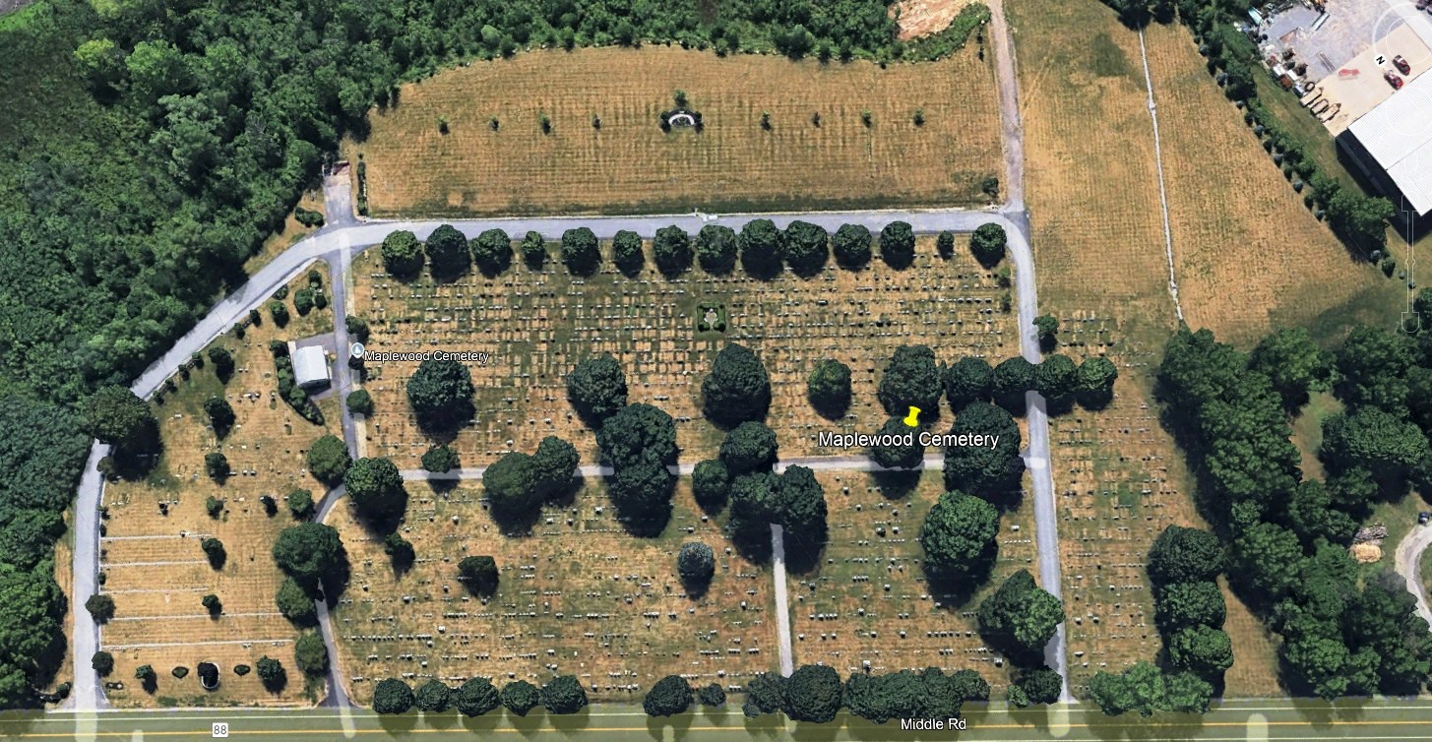

Slide 2
Section L
Section M
Future South Section(s)
Section F
Section H
CRE
Section D
Section C
Section K
Section J
Section A
Section B

