Slide 1
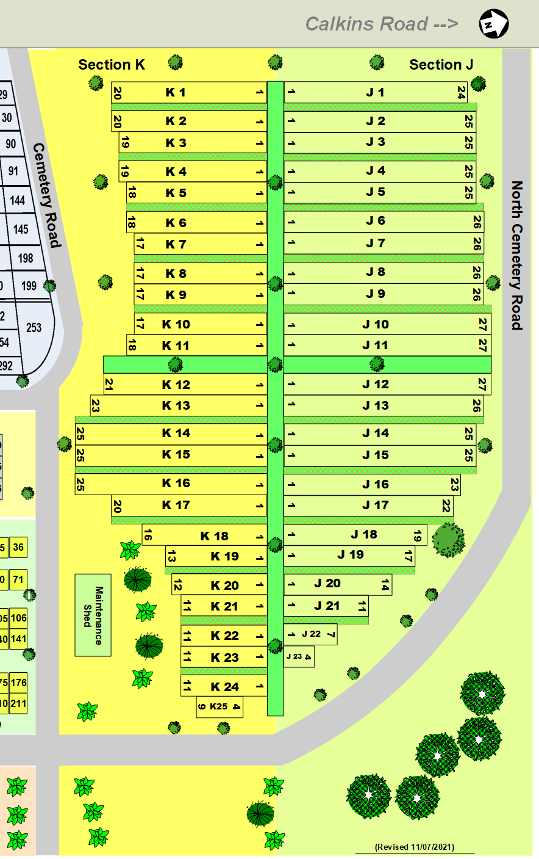

Conderman
Beikirch
Laird
Bocklage, Waterstreet
McQuoid
Feasel
Brice
Hodges
Carrick
Stockmaster
George & Virginia Lewick
Christoff
Tougas
Pelliter
Robert & Adelene Smith
Wallace Family
Wm Wallace II
Kester
Mary Wallace
Wilson
Ketavong
Wallace Family
Dubois
Served MWC
Rusinovich
Wilson
Lewick Family
Wilson
Stuver
Prill
Gifford
Patty & Danny
F Section
Noma Betron (2)
Revised 1/18/2023

