Slide 1
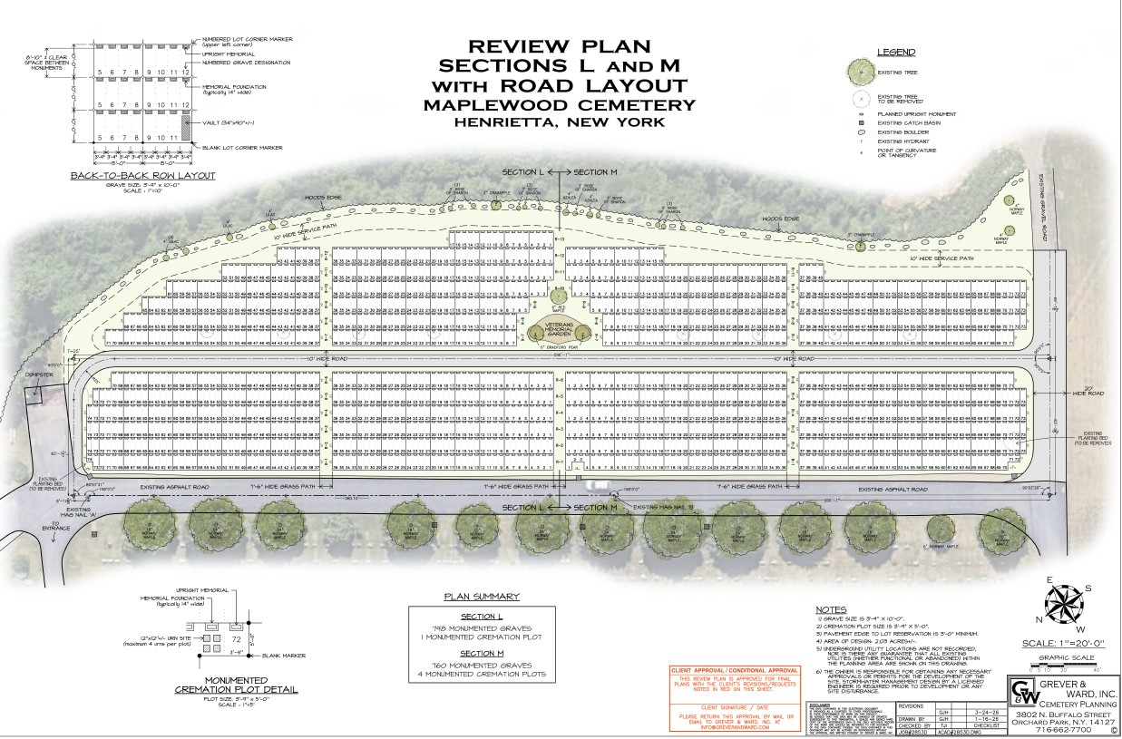

Slide 2
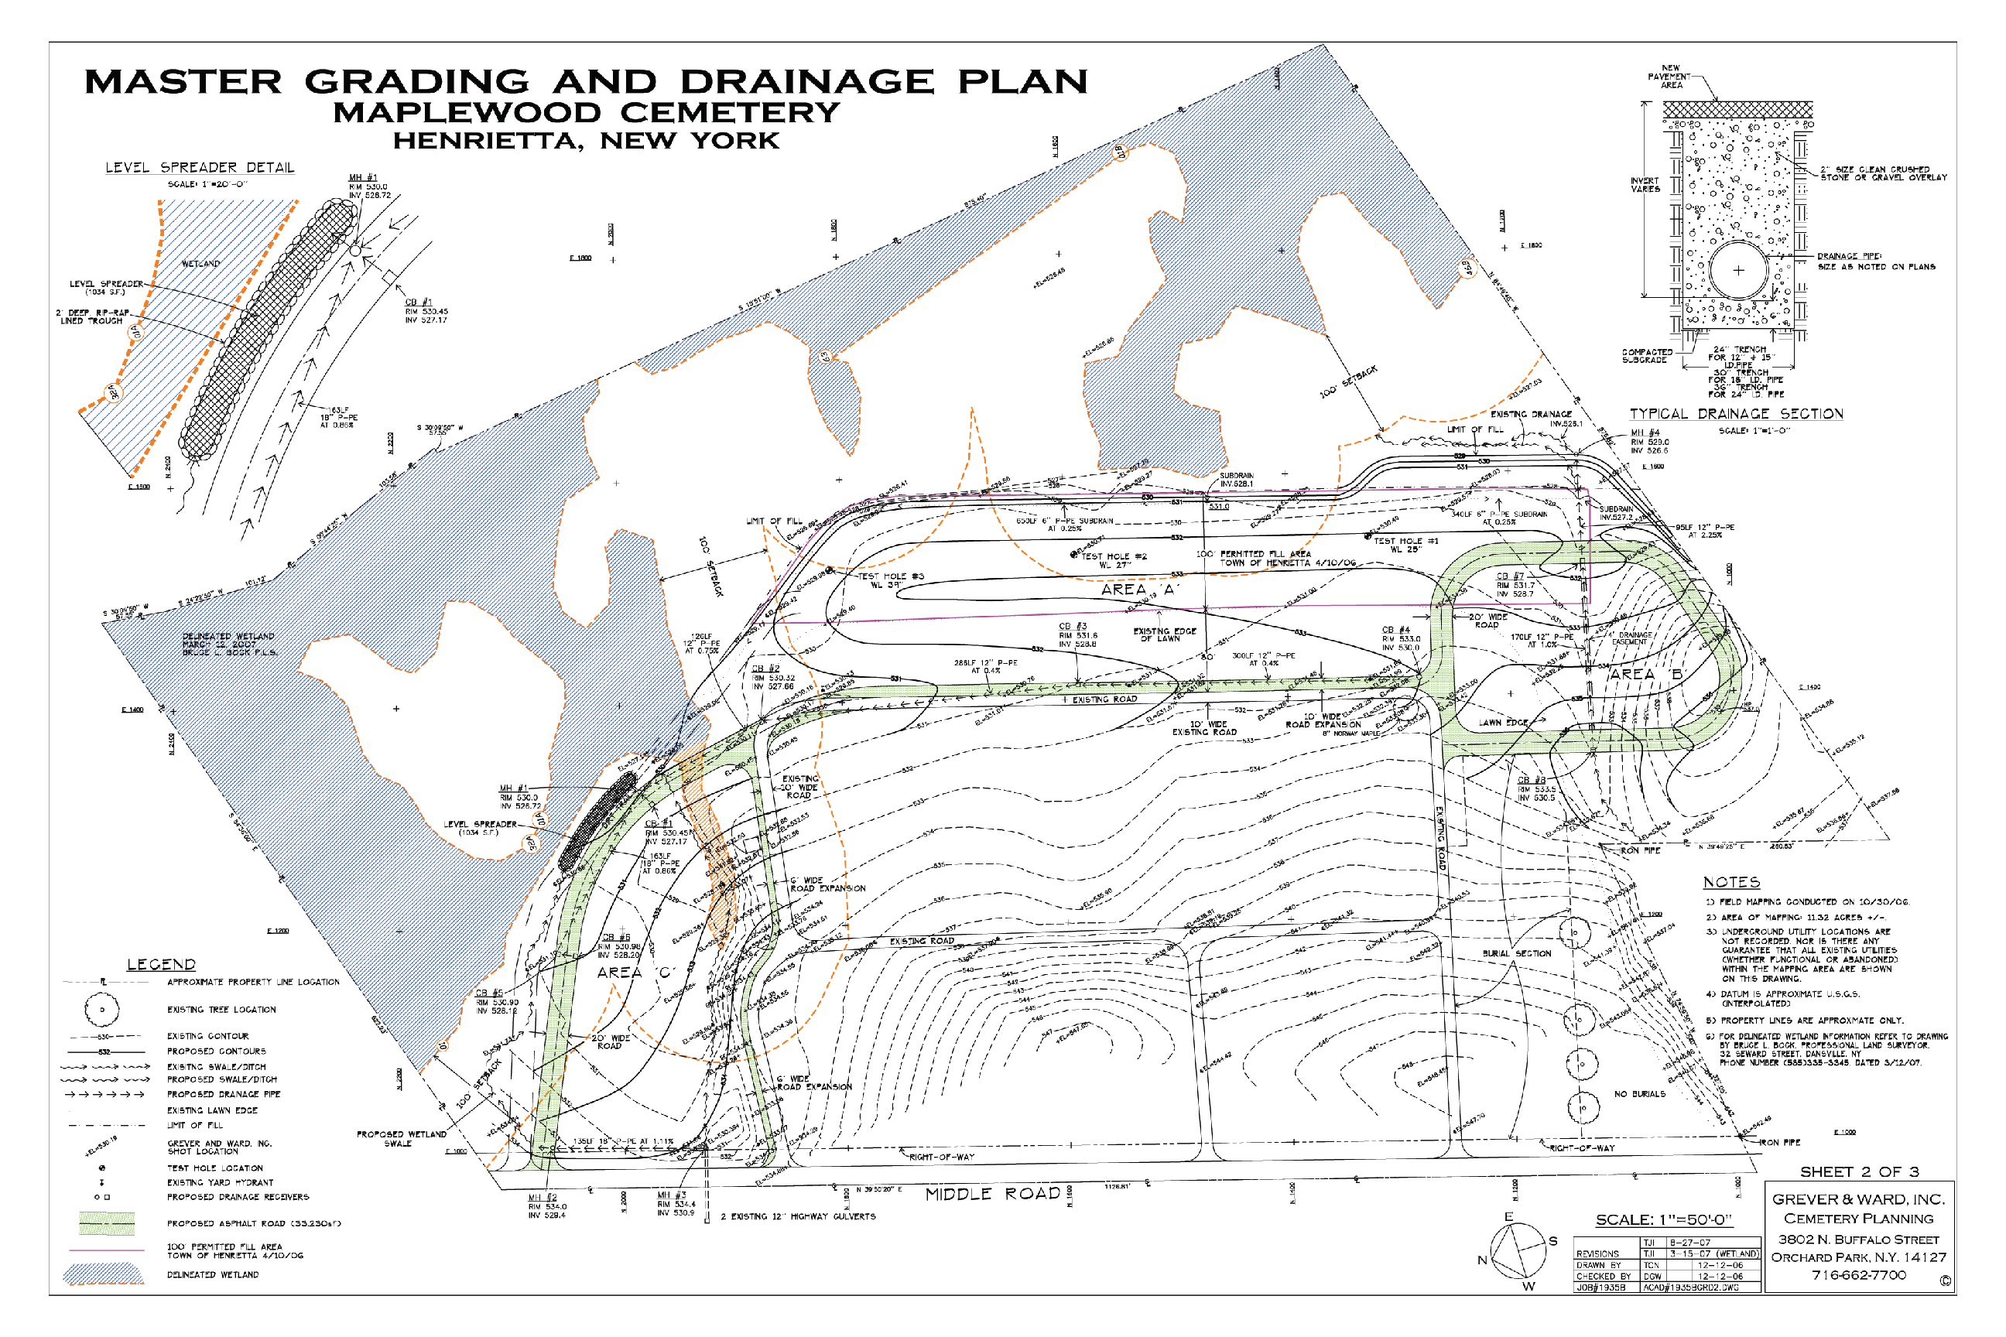
Maplewood Cemetery – 2009 Expansion Project
Indicated area for 2009 fill permit
2008 – Completed Expansion Project South Area
Existing Developed Cemetery
2008 – Completed Expansion Project North Area

Slide 3
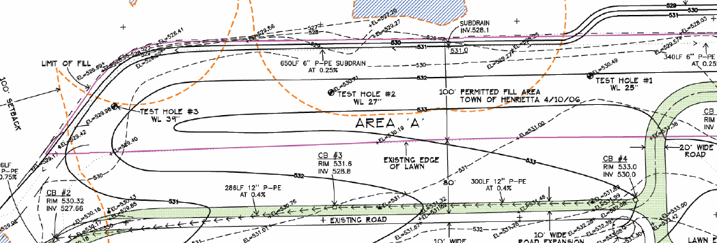
Maplewood Cemetery – 2009 Expansion Project
East area fill required to complete submitted Master Plan. Area size is approximately 650’ x 180’.
Fill required to raise east area 3 to 4 feet, in gradual grade to center, as shown below.
The berm that is currently along the existing east road is topsoil that will be spread over the new fill to complete the east area grading.
The drainage system shown along the existing east road is complete. The construction access road has been upgraded to millings to reduce the dirt tracked from the trucks to Middle Road. Villager Construction will be the primary contractor.
The completed north and south 2008 expansion projects have been 100% stabilized. The SWPP plan remains in place and inspections will change from the current once a month, to the required once a week schedule once work is resumed in the April-May 2009 timeframe.
East Area
New drainage system completed in 2008

Slide 4
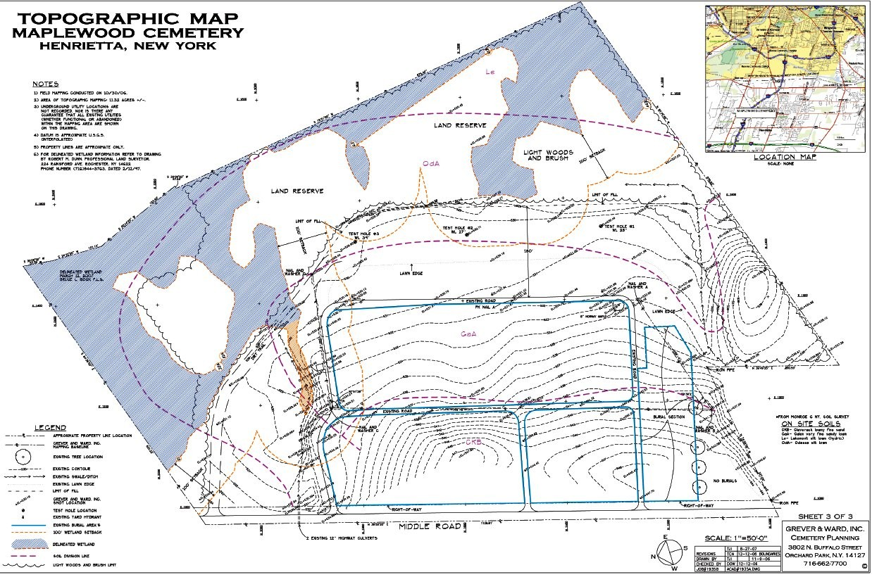

Slide 5
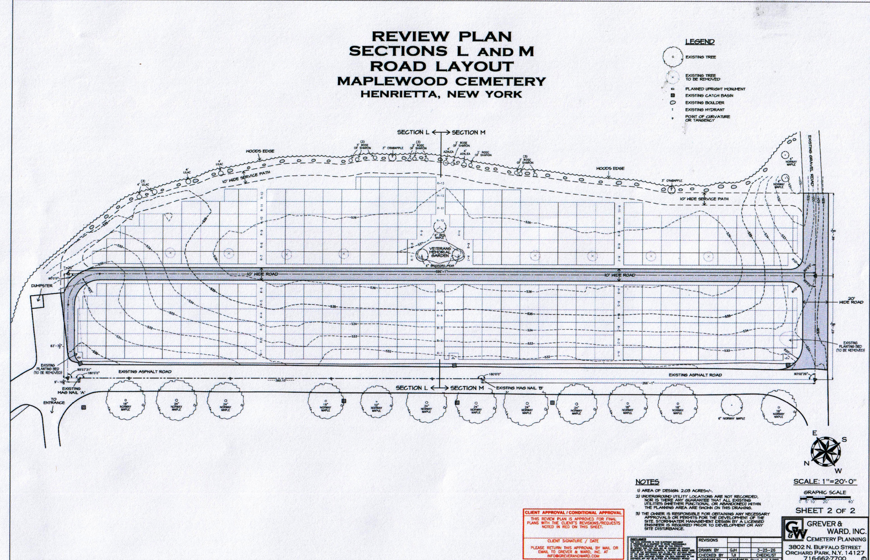

Slide 6
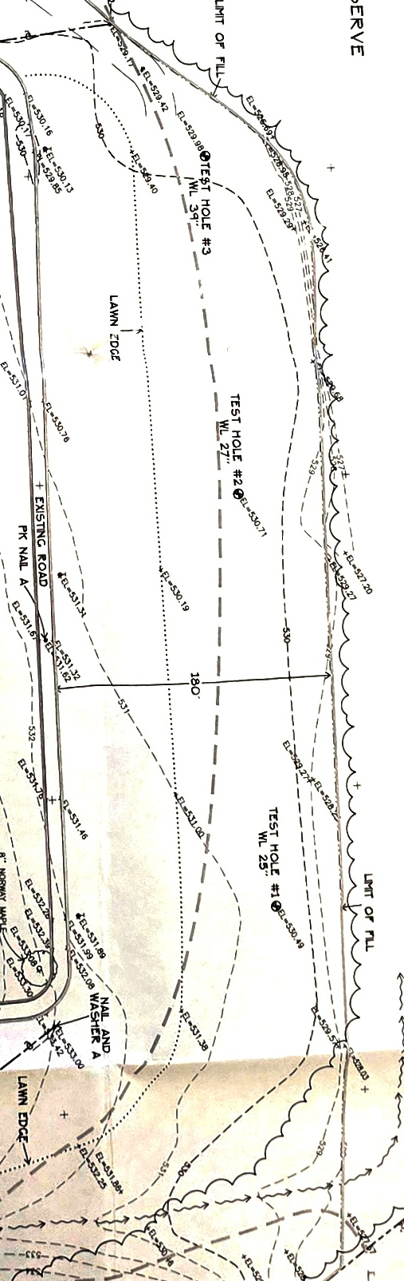
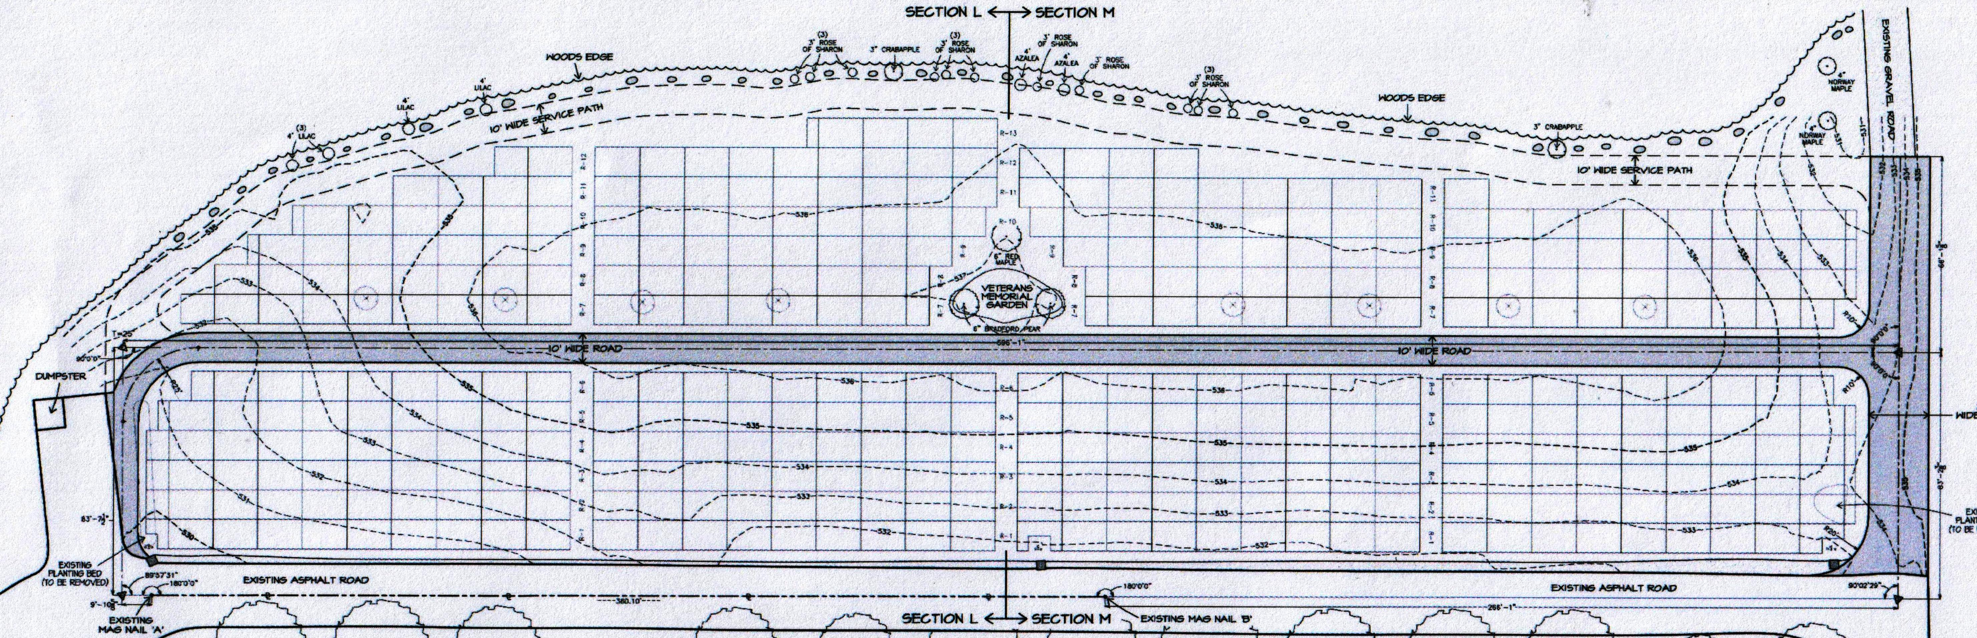
530
530
530
531
531
536
532
536
534
536
532
534
534
530
532

