Slide 1
Maplewood Cemetery – East Hill Development Project
Phase 1: Initial GPS mapping of east hill
  Conceptual layout planning proposals
  Review and modifications of layout
Phase 2: Review and approval of final proposal
  Possible modifications to be reviewed.
  Pricing proposal to formally design the approved layout.
Phase 3: Preparation for implementation
  Order required materials, such as lot/grave markers.
  The cost and lead time are TBD
  Rough layout of new infrastructure positioning, such as new road.
  Request review and implementation time and costs with the Town for the construction of the new road and possible the rear service road.
Phase 4: Implementation
  Road construction. Cost TBD
  Lot/grave marker installation. Cost TBD

Slide 2
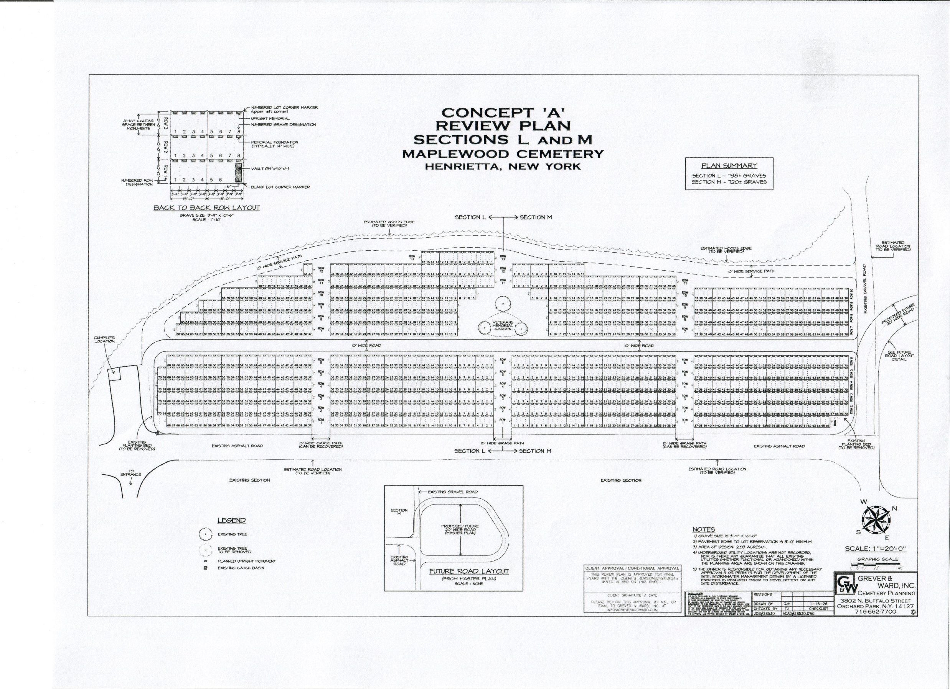

Slide 3
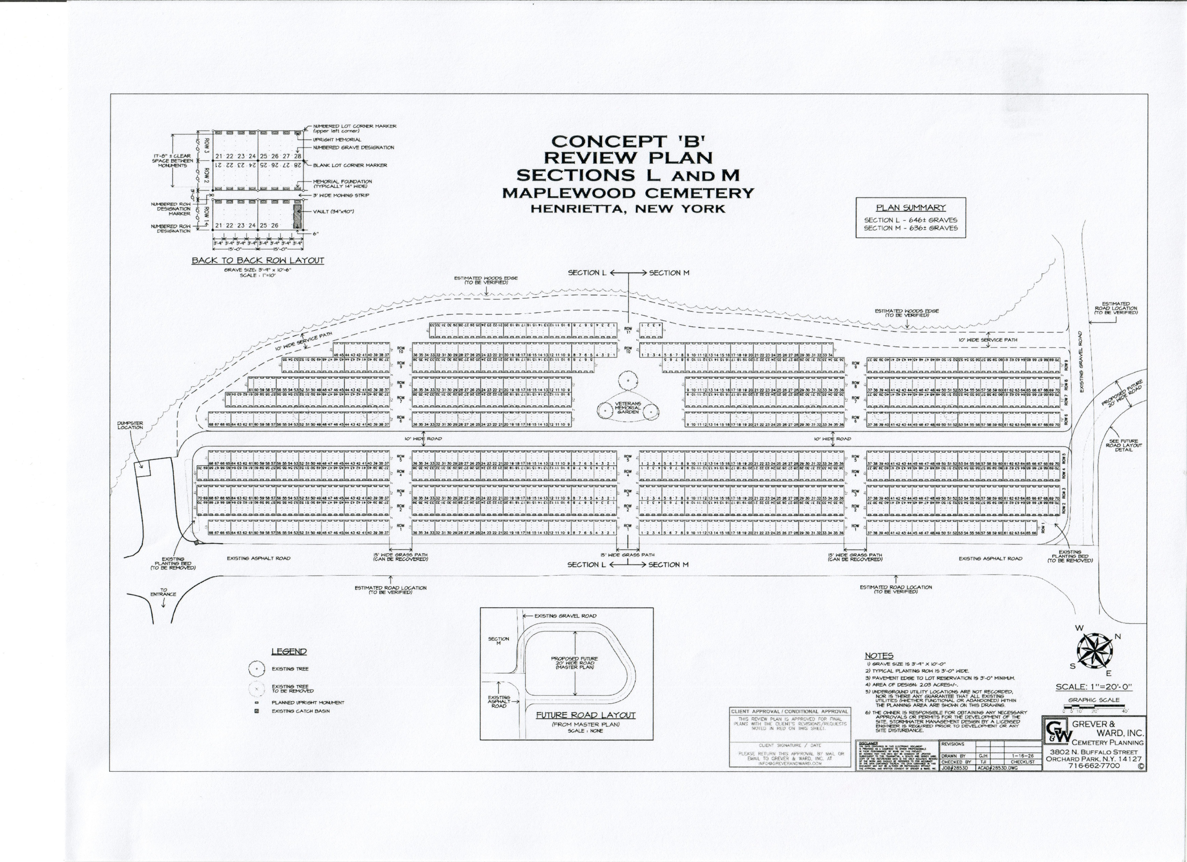

Slide 4
