Slide 1
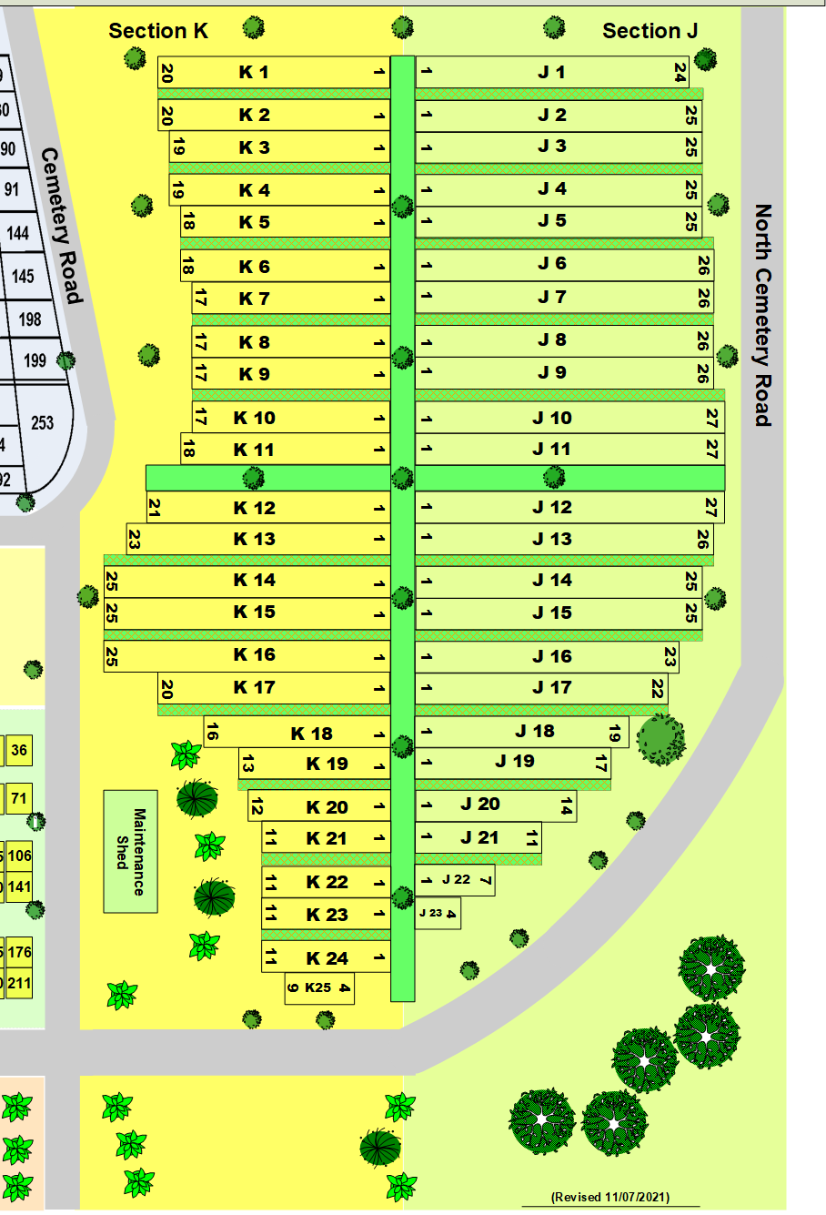
Conderman
Beikirch
Laird
Waterstreet
Bocklage, Waterstreet
McQuoid
Feasel
Brice
Hodges
Carrick
Stockmaster
George & Virginia Lewick
Christoff
Tougas
Ketavong
Pelliter
Robert & Adelene Smith
Wallace Family
Wm Wallace II
Kester
Mary Wallace
Wilson
Wallace Family
Dubois
Lewick Family
Rusinovich
Wilson
Wilson
Stuver
Prill
Gifford

