Slide 1
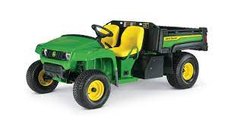
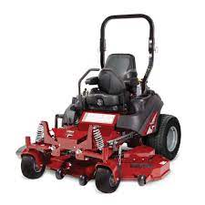
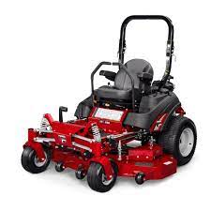

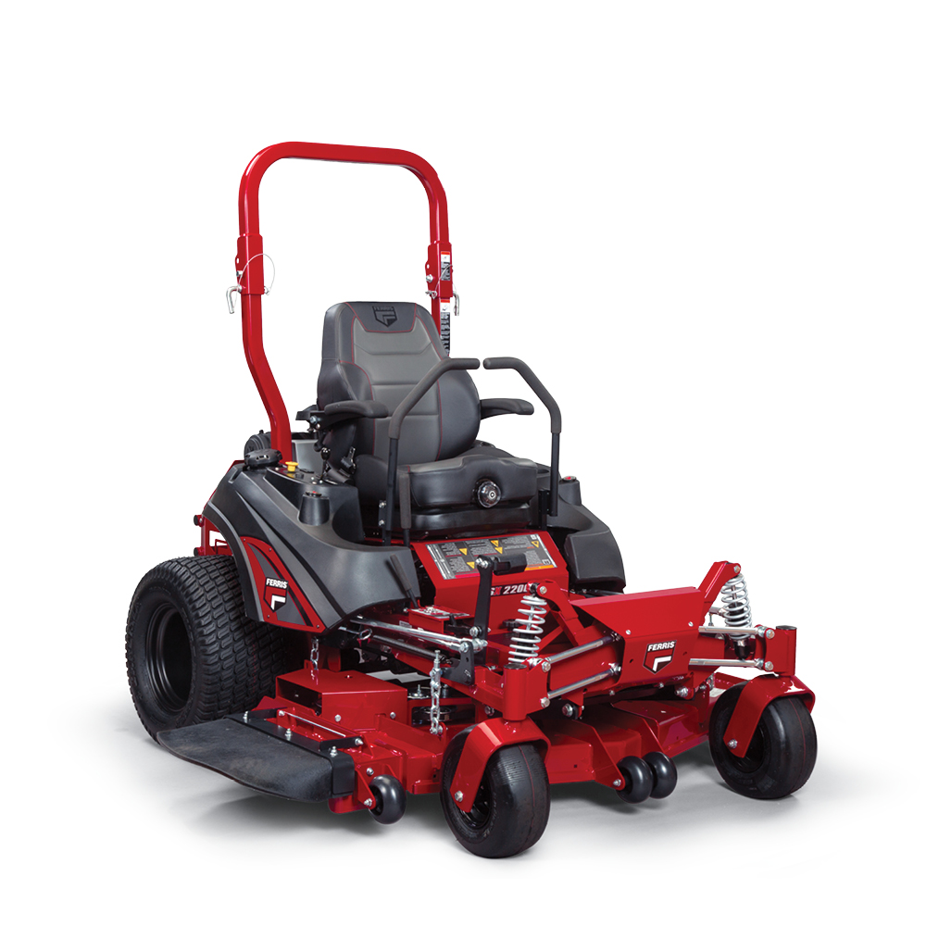
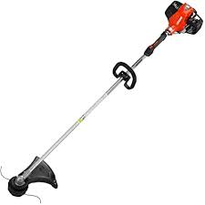

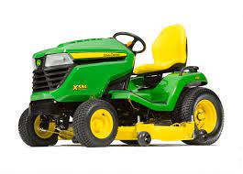
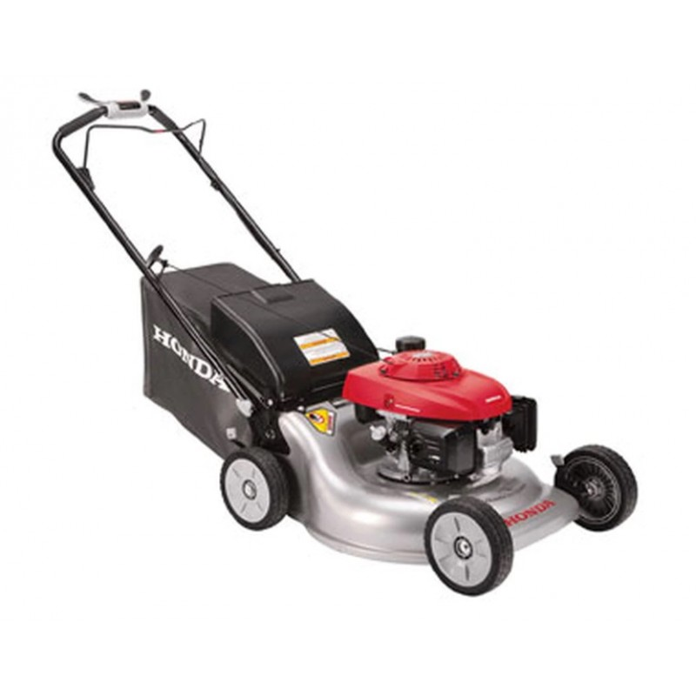
Maplewood Cemetery Association - Equipment Purchases
5/2010 John Deere Gator
TS 4x2, power lift
5/31/2014 Ferris – Briggs & Stratton: IS2100 Model 5901304
Kohler EVC749 Command Pro EF, 2 7hp 61” deck
4/28/2020 Ferris – Briggs & Stratton: ISx800ZB2752 SS 52” deck
10/25/2021 John Deere 2032R Compact Utility Tractor
With loader bucket
6/20/2024 Ferris ISX™ 2200 Zero Turn Mower
Model 5902078, 60” deck
Vanguard™ 810cc EFI with Oil Guard
11/20/2018 Echo Trimmer
SRM3020 30.5cc straight shaft
6/2015 Scag Cheetah, SCZ48V-23CV-EFI, 23 HP Kohler EFI, 48” deck
SOLD: 6/18/2024
5/2010 John Deere Mower
X534 M-T 4WS 48” deck
SOLD: 4/28/2020
9/13/2016 Honda 21” Mower, HRR216K9VKA
SOLD: 11/01/2021

