Slide 1

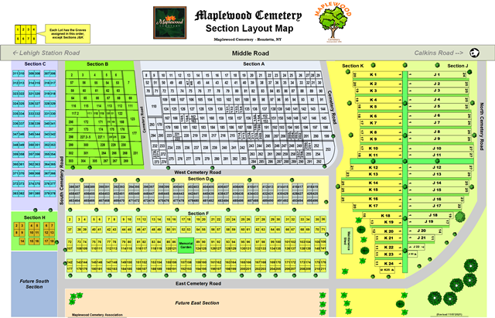
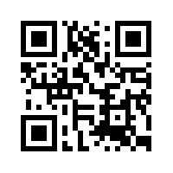
Welcome to Maplewood Cemetery!
A Not-for-Profit Community Cemetery
All visitors must comply with the Cemetery Rules & Regulations.
Rules & Regulations - Summary
Permitted
Prohibited
Please enjoy and respect our Cemetery and help keep it clean.
Flowers may be placed or planted up to 36” from the back of the headstone.
Christmas wreaths must be removed by March 15th.
Decorations and free standing items should be placed on the headstone base or foundation.
Pets must be leashed and cleaned up after.
No shrubs, rose bushes, or trees.
No fences, stone edging, glass or plastic blocks or vases, wooden crosses or shepherd crooks. This includes banner or flag stands.
No solar lights, candles. No ‘Pin-Wheels’ or similar devices
No parking or driving on the grass. Please find a parking spot that won’t interfere with others.
Please note that valuable items should not be left at the cemetery.
Maplewood retains the authority to remove any items.
(Use the QR code to view the complete Rules & Regulations at MaplewoodCemetery.org)

