Slide 1
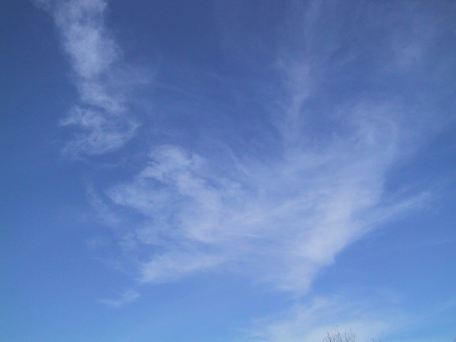
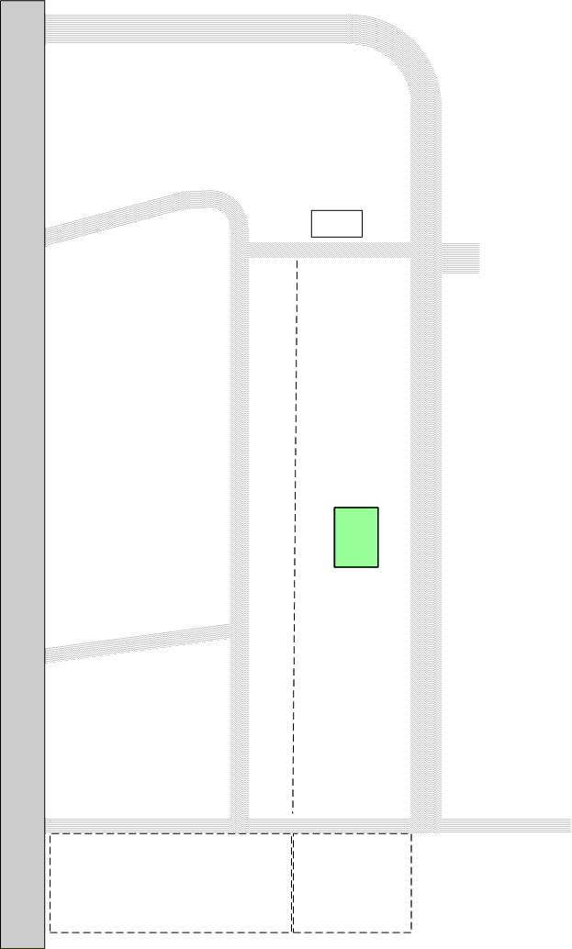

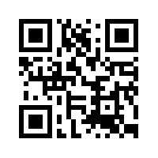
Welcome to Maplewood Cemetery
Henrietta, NY 14467
Maplewood Cemetery Association is a not for profit, charitable, volunteer run organization.
Please contact us if you would like to volunteer.
#1
North Cemetery Road
Section J
Section K
You are Here
#2
Shed
Section A
Section F
The Maplewood Cemetery
Is regulated by the
New York State Cemetery Board
Cemetery Contact:
Scott - Superintendent
(585) 672-1020
For further information or questions contact
NYS Division of Cemeteries:
Buffalo Office (716) 847-7101
Middle Road
Future Section
Section D
East Cemetery Road
Memorial Garden
#3
Section B
#4
South Cemetery Road
Service Road
Info@MaplewoodCemetery.org
Or on the Internet at:
www.MaplewoodCemetery.org
Section C
Section H
Future Section
Please observe the Cemetery Rules & Regulations at all times
Open from Dawn to Dusk Daily

