Slide 1
Maplewood Cemetery Association
(Same orientation)
Grave / Lot Markers
0109
Adjacent Grave Corner Marker (1)
0108
Numbered Grave Corner Marker
Row # (01-25)
Grave # (01-27)
Placed at head end of lots (of 4 graves) as indicated on Grever & Ward North Section Plan
0109
0108
Using J. DeFontes, Co #5X52R cast aluminum lot markers
Note (1): Adjacent Grave # may be blank if row begins or ends at the designated end of a lot of 4 graves)
(Reverse orientation, as shown in mfg catalog)

Slide 2
Maplewood Cemetery Association
Section & Row Markers
Section J Row 01
Section J Row 02 (1)
Row # (01-25)
J01
J02
Section J or K
Placed at each end of row and at center median at grave 1
Using J. DeFontes, Co #5X52R cast aluminum lot markers
Note (1): Adjacent Row # may be blank at last row, (odd number of rows).

Slide 3
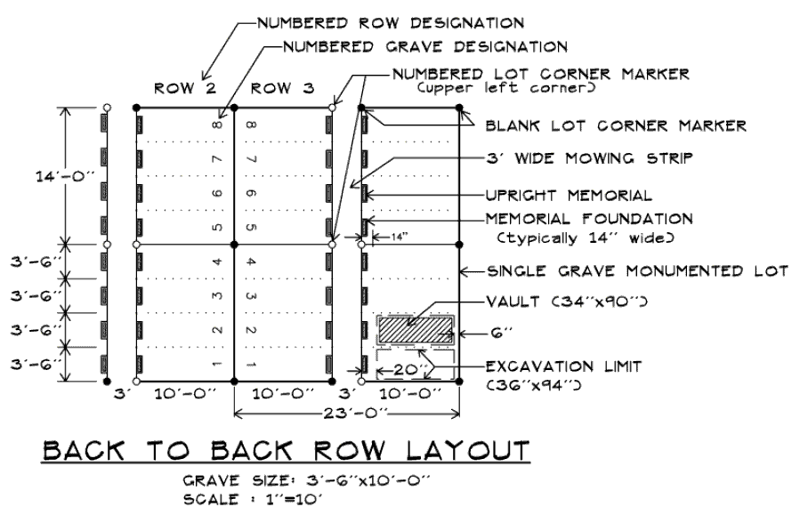
Maplewood Cemetery Association
0205
0204
Row & Grave Markers
0105
0104
Placed at each end of row and at center median at grave 1
J01
J03
Grave, Section & Row Markers
Section & Row Markers
J02
J04

Slide 4
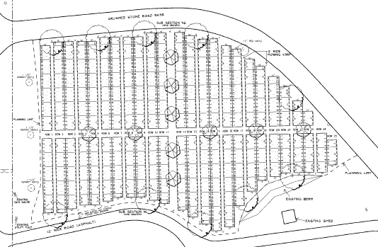
N
Maplewood Cemetery Association
Row 01
Row 11
Row 23
Section J
Graves 01- 24
Graves 01- 27
Center Median
Graves 01- 21
Graves 01- 19
Section K
Row 01
Row 11
Row 23

